Slide 1
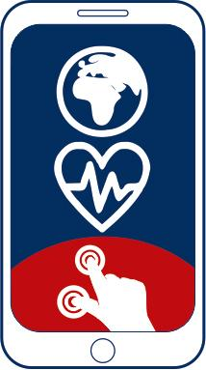
1
7
2
8
3
9
https://apps4health.eu/
4
Module 1 - Teaching session (1.1) General awareness on the relevance of self-management and Health apps
10
5
11
6
Funded by the European Union. Views and opinions expressed are however those of the author(s) only and do not necessarily reflect those of the European Union or the European Education and Culture Executive Agency (EACEA). Neither the European Union nor EACEA can be held responsible for them.

Slide 2
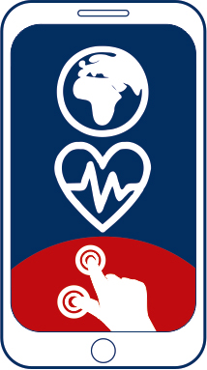
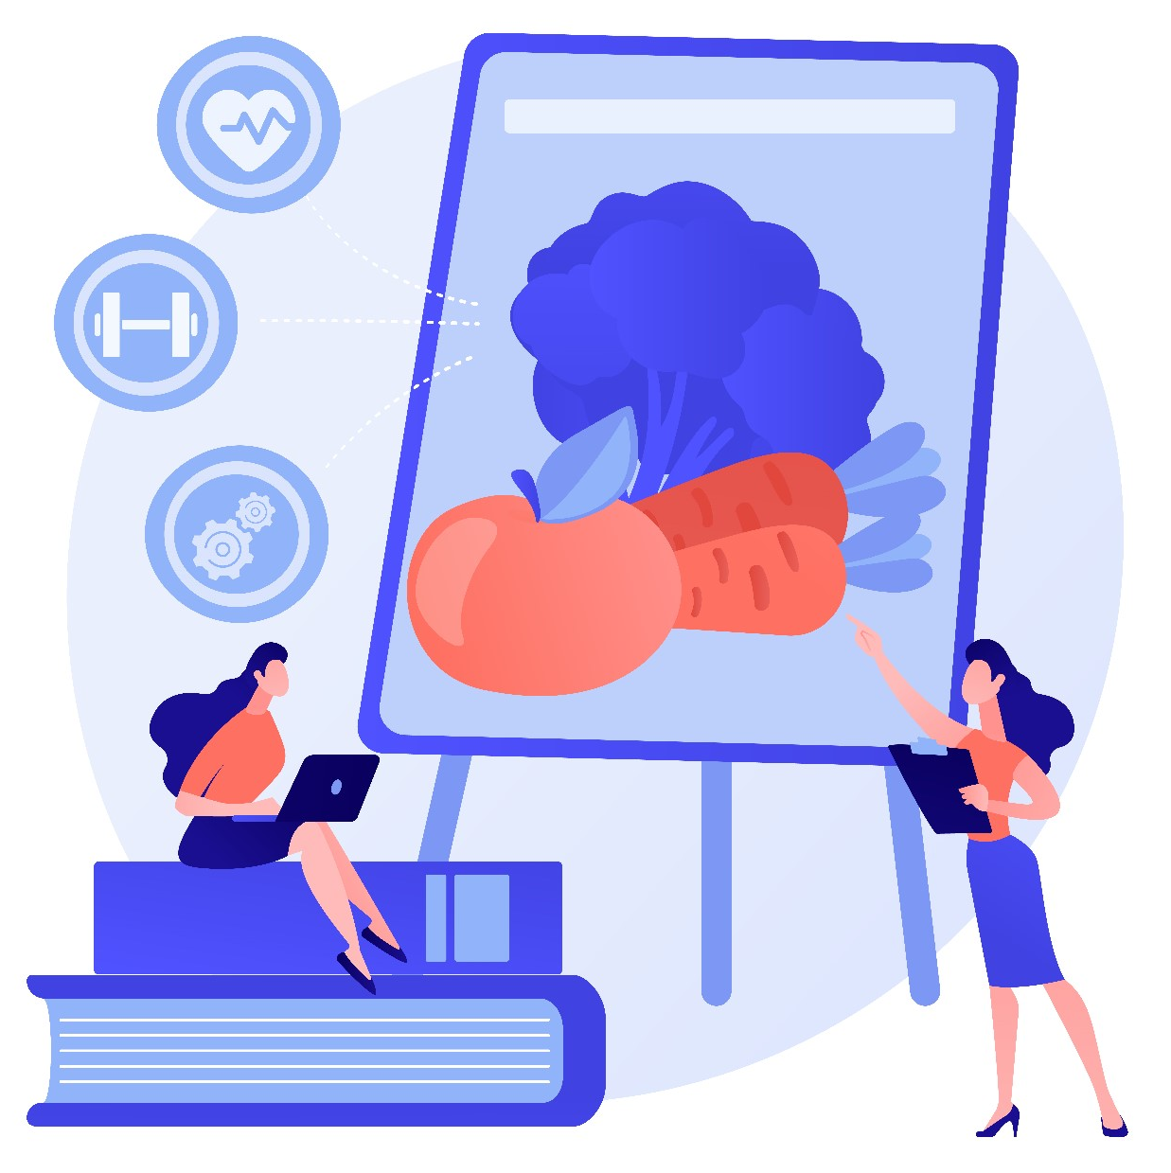
1 General awareness on the relevance of self-management and Health apps

Slide 3
Partners
UNIVERSITAT DE VALENCIA
VALENCIA, SPAIN
www.uv.es
PROLIPSIS
ATHENS, GREECE www.prolepsis.gr
WESTFALISCHE HOCHSCHULE GELSENKIRCHEN, BOCHOLT, RECKLINGHAUSEN
GELSENKIRCHEN, GERMANY
www.w-hs.de
OXFAM ITALIA INTERCULTURA
AREZZO, ITALY
www.oxfamitalia.org/
CONNEXIONS
ATHENS, GREECE
www.connexions.gr
RESET
CYPRUS
www.resetcy.com
media k GmbH
Bad Mergentheim, GERMANY
www.media-k.eu
COORDINA ORGANIZACIÓN DE EMPRESAS Y RECURSOS HUMANOS, S.L.
VALENCIA, SPAIN
coordina-oerh.com
AMSED
STRASBOURG, FRANCE
www.amsed.fr

Slide 4
Ice-breaking activities
1
10
General awareness on the relevance of self-management and Health apps
1

Slide 5
Who are you?
The goal of the activity is to help the learners introduce themselves through pictures and images and it can be conducted with the support of online tools (e.g. Mentimeter), printed images or cards (e.g. Dixit).
Every participant will choose the picture that best represents her/him and explain why.
Source| Pixabay license

Slide 6
Who are you?
Show the learners a big map of the world representing the country according to where they came from. Ask them several health-related questions and listen to the answers – they might be similar or different according to country.
Encourage people to share a short personal story if they want.

Slide 7
Who are you?
All participants stand in a circle. One by one, they say their name and answer a question chosen by the moderator to break the ice, for example: What would be your superhero name, What is the last dream you remember, My friends adore me for my ...
Source| Pixabay license

Slide 8
3 examples for icebreaker questions
What home remedy is used for headaches in your country of origin?
What did your mother/father do when you were a child and had itchy mosquito bites?
Which food do you regard as specifically healthy and nutritious?
Source | Pixabay license

Slide 9
Teaching Session: Content
1. Introduction to health-self management for migrants
2. Main concepts on Health Apps
3. Navigating Health Apps

Slide 10
What we are going to talk about…
1
1
10
General awareness on the relevance of self-management and Health apps
1
1
Introduction to health-self management
What is the Mig Health Apps project?
Main concepts on Health Apps and Mig-Health Apps programme
Navigating Health Apps
Source: Image by nuraghies on Freepik

Slide 11
Competences
1
1
1
10
General awareness on the relevance of self-management and Health apps
1
1
Identify the health areas more relevant
Identify the main areas where learners’ health self-management can be reinforced
Acknowledge how health apps can be useful for individuals
Image by vectorjuice on Freepik

Slide 12
1.1.1 Introduction to health-self management for migrants
Objectives
To learn about the importance of health-self management and how it can help prevent or manage some health problems
Designed by Freepik

Slide 13
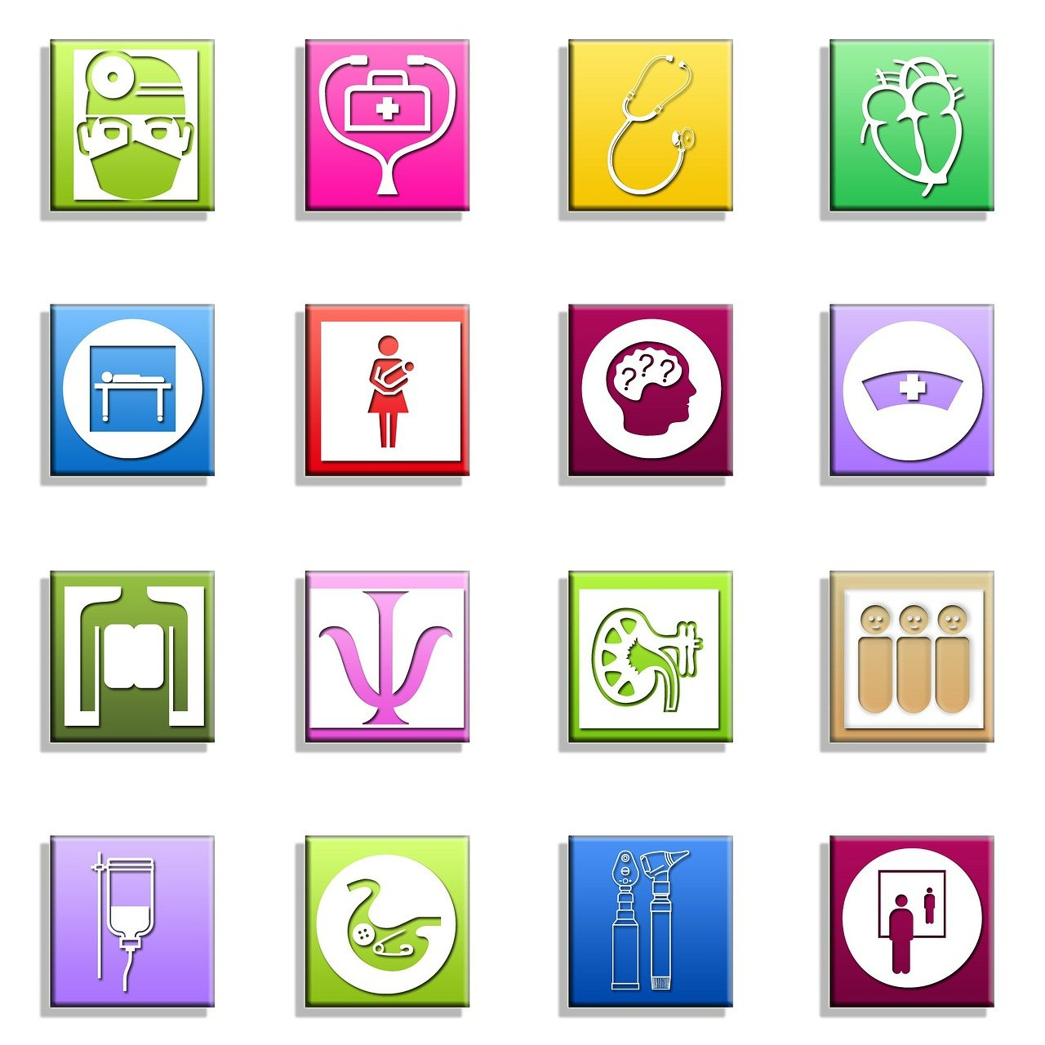
Health-self management for migrants
Citizens can monitor their health, adapt their lifestyle and even interact with their doctors, careers or supports by receiving and providing feedback.
Health Apps support migrants’ well-being, empowerment and self-affirmation, and can specifically improve their health status and integration in the host country.
Source | Palabay license

Slide 14
What is the Mig Health Apps project? (1)
The aim of MIG-HEALTH APPS is to increase the competences of migrants in using health apps. For this purpose, a partnership of nine European institutions developed an Experiential Training Methodology based on a “learning by doing” approach, where learners are involved in self-management situations. They apply real health apps to their own conditions to get familiar with processes and technologies in a supported training environment.

Slide 15
What is the Mig Health Apps project? (2)
A set of training resources which promotes the adoption of health apps by migrants:
an e-training platform and
an app training tool
support the implementation of the training.

Slide 16
1.1.2 Main concepts on Health Apps
Objectives
To identify and categorise health apps
To identifying health apps that can be useful
Designed by Freepik

Slide 17
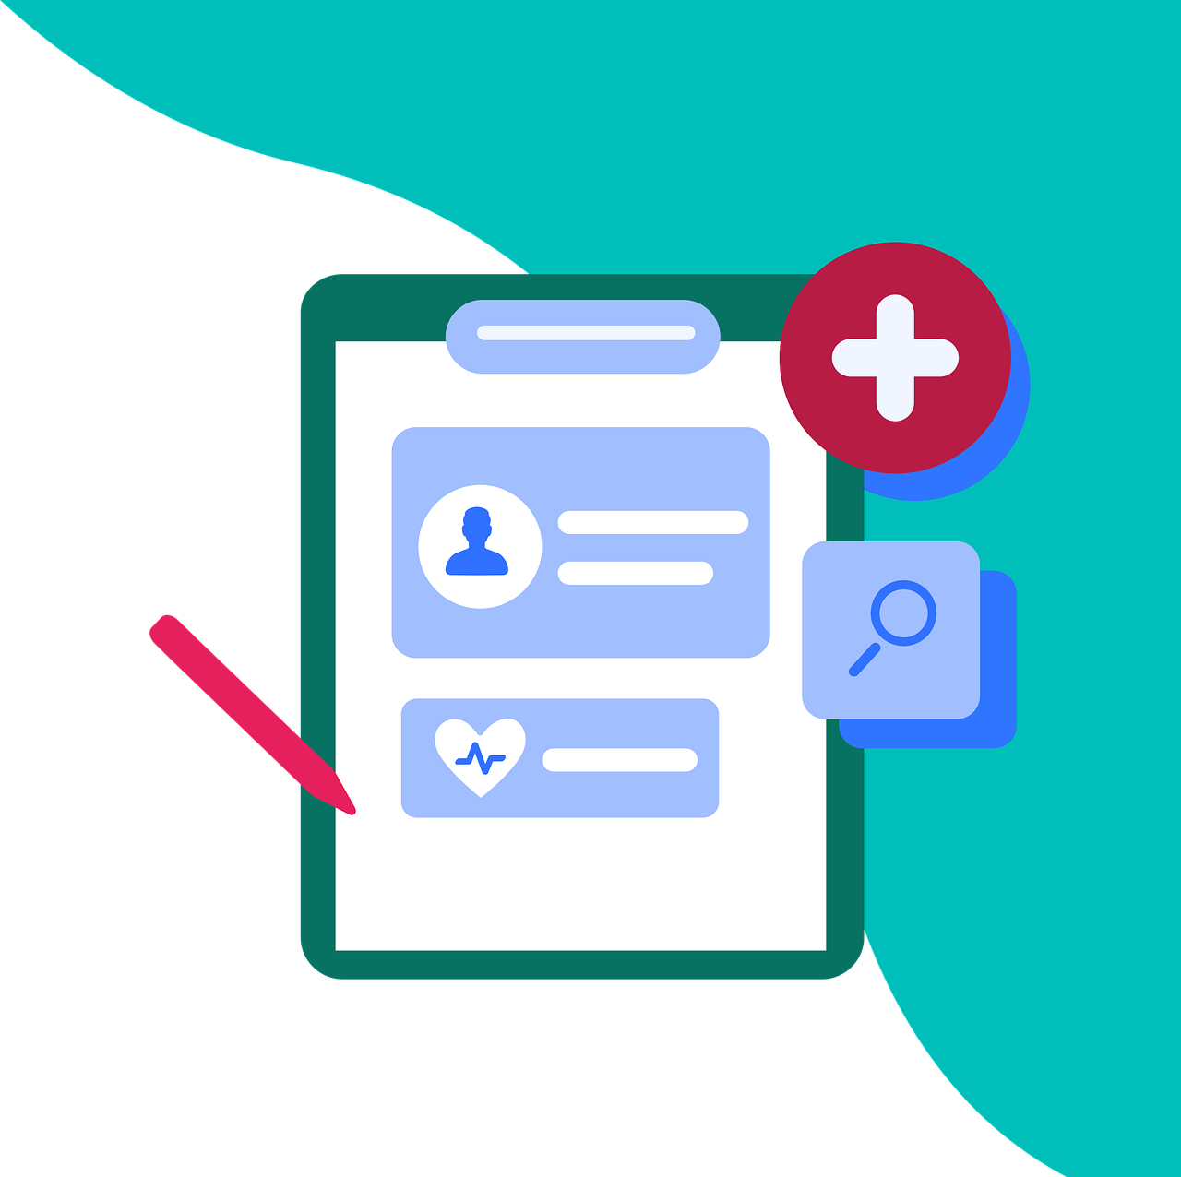
What is a Health App? (1)
1.1.2 Main concepts on Health Apps
The use of health applications has been increasing in recent years and can be a useful resource to enhance the well-being of migrants.
There are more than 160,000 mobile health apps available in commercial app shops, most of which are targeted at people seeking to manage or prevent chronic diseases.
Apps are poised to become a major source of health guidance.
Source | Pixabay license+

Slide 18
What is a Health App? (2)
1.1.2 Main concepts on Health Apps
Health apps can promote health and primary disease prevention and help people with chronic diseases to manage their medical conditionsor improve treatment adherence. In addition, apps offer the opportunity to increase patients' autonomy.
Apps can not only help improve or monitor health, but can also play an important role in health economics, as they can help save costs and increase the utility of healthcare systems.
Source | Palabay license

Slide 19
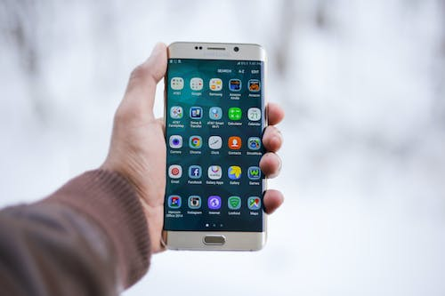
What the Mig-Health App programme offers (1)
1.1.2 Main concepts on Health Apps
The Training Program is structured into a set of “Experiential Training Activities”, which are divided into the following sessions:
Teaching session
Experiential training session
Self-learning supported by online training tools
Closure session
Source | Pexels license

Slide 20
What the Mig-Health App programme offers (2)
1.1.2 Main concepts on Health Apps
1. Teaching session
Session in which the trainer introduces the trainees to the main content related to the topic of the experiential activity. This can be done "face-to-face" or with the support of e-learning tools. The session includes the following group dynamics:
Group dynamics; Why this health field is relevant as well as best practices
Group dynamics; How health Apps can support self-management within this area of healthcare.

Slide 21
What the Mig-Health App programme offers (3)
1.1.2 Main concepts on Health Apps
2. Experiential training session
Learners will be invited to select, at least, one Health App in the related health area. They will then be supported by the trainer in the process of testing and applying the Health App to their own health/life situation.

Slide 22
What the Mig-Health App programme offers (4)
1.1.2 Main concepts on Health Apps
3. Self-learning session supported by online training tools
The learners will be invited to complete and assess their knowledge through complementary readings and practical activities. These exercises are to be implemented with the support of e-learning tools and the trainer.

Slide 23
What the Mig-Health App programme offers (5)
1.1.2 Main concepts on Health Apps
4. Closure
In this session, learners will be invited to share their experiences with the use of Health Apps.

Slide 24
What the Mig-Health App programme offers
1.1.2 Main concepts on Health Apps
The contents of the programme are structured around 11 different topics organized in Experiential Training Activities (ETAs).
Users can navigate through one or all of them, depending on their interest.
ETA1. General awareness on the relevance of self-management and Health Apps
ETA2. How to search and select Health Apps
ETA3. Health Apps for Physical Activity
ETA4. Health Apps for Rest Routines
ETA5. Health Apps for Substances Use
ETA6. Health Apps for Nutrition
ETA7. Health Apps Women's Health
ETA8. Health Apps for Children's Care
ETA9. Health Apps for the Elderly
ETA10. Health Apps for Mental Health Problems
ETA11. Health Apps for Healthcare Services

Slide 25
1.1.3 Navigating Health Apps
Objectives
To go through different health apps.
To navigate through app interfaces, exploring core features and settings.
Designed by Freepik

Slide 26
Activity
1.1.3 Navigating Health Apps
Participants will be separated into small groups and will access the Mig-Health Apps platform, browse through the ETAs and decide if any of the offered apps can be useful for them.
Source | Pexels license
Image by vectorjuice on Freepik

Slide 27
DISCUSSION
1.1.3 Navigating Health Apps
Questions?
Clarifications?
Comments?
Source | Pixabay license

Slide 28
References and further Readings
Kampmeijer, R., Pavlova, M., Tambor, M., Golinowska, S., & Groot, W. (2016). The use of e-health and m-health tools in health promotion and primary prevention among older adults: a systematic literature review. BMC health services research, 16, 467-479.
Biswas, M., Tania, M. H., Kaiser, M. S., Kabir, R., Mahmud, M., & Kemal, A. A. (2021). ACCU3RATE: A mobile health application rating scale based on user reviews. PloS one, 16(12), e0258050.
Ahmed, I., Ahmad, N. S., Ali, S., Ali, S., George, A., Danish, H. S., & Darzi, A. (2018). Medication adherence apps: review and content analysis. JMIR mHealth and uHealth, 6(3), e6432.

Slide 29
Congratulations!
You have completed the teaching session of this module!
This project has been funded with support from the European Commission. This publication (communication) reflects the views only of the author, and the Commission cannot be held responsible for any use which may be made of the information contained therein.

