Slide 1


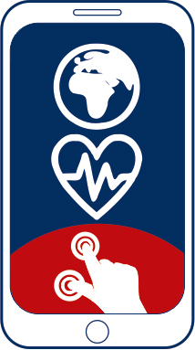


1
7
2
8
3
9
https://apps4health.eu/
4
Module 7 - Experiential Training session (7.2)
Women’s Health and relevant Apps
10
5
11
6
Funded by the European Union. Views and opinions expressed are however those of the author(s) only and do not necessarily reflect those of the European Union or the European Education and Culture Executive Agency (EACEA). Neither the European Union nor EACEA can be held responsible for them.

Slide 2











Partners
UNIVERSITAT DE VALENCIA
VALENCIA, SPAIN
www.uv.es
PROLEPSIS
ATHENS, GREECE
www.prolepsis.gr
WESTFALISCHE HOCHSCHULE GELSENKIRCHEN,
BOCHOLT, RECKLINGHAUSEN
GELSENKIRCHEN, GERMANY
www.w-hs.de
OXFAM ITALIA INTERCULTURA
AREZZO, ITALY
www.oxfamitalia.org/
CONNEXIONS
ATHENS, GREECE
www.connexions.gr
RESET
CYPRUS
www.resetcy.com
media k GmbH
Bad Mergentheim, GERMANY
www.media-k.eu
COORDINA ORGANIZACIÓN DE EMPRESAS Y
RECURSOS HUMANOS, S.L.
VALENCIA, SPAIN
coordina-oerh.com
AMSED
STRASBOURG, FRANCE
www.amsed.fr

Slide 3
Experiential Training Session: Content
1. Specific Examples of Women’s Health Apps
2. Real life integrations

Slide 4

Objectives
7
Women’s Health and relevant Health Apps
Help learners become familiar with Women’s Health apps.
Provide real-life scenarios and situations of how women’s health apps may help a womans’ health in general.
Source: Image by nuraghies on Freepik

Slide 5

Competences
1
Women’s Health and relevant Health Apps
7
To equip participants with the skills required to benefit from the use of Women’s Health Apps.
To enhance the skills needed to make informed decisions about app selection, utilization, and integration into participants’ everyday-life, if they wish to do so.
Image by vectorjuice on Freepik

Slide 6

7.2.1
Specific examples of Women’s Health related Apps
Objectives
To be familiar with the most common types of Women’s Health Apps.
To identify and categorize app’s type, main features and sections.
To be familiar with using an app for the first time.
Designed by Freepik

Slide 7

Example 1:
Euki – Period Tracking App
Period Tracking App offering comprehensive sexual and reproductive health information; A supportive, inclusive, and customizable interface; Privacy and security. Features:
CALENDAR AND LOGGING: track bleeding, emotions, body changes, sex, contraception, and appointments; Track pregnancy or STI tests and their results; Find patterns in menstrual cycle or body changes that happen around the period; Write notes to share with a health care provider at the next appointment.
PRIVATE REMINDERS: Set one-time or repeated reminders for sexual health needs, like taking pills, taking a pregnancy test; Receive discrete reminders so that no one will know the details of one’s personal life.
ABORTION AND MISCARRIAGE SUPPORT: Learn about medication and surgical abortion; Prepare for a clinic appointment; Browse FAQs to answer any quick questions that you have and connect to trusted resources for more information; Read stories from other people who’ve had abortions and miscarriages.
INTERACTIVE CONTRACEPTION INFORMATION: Learn about options that meet your needs through an interactive quiz; Connect to detailed information about methods that interest you most.
FACTS ABOUT SEXUALITY: Scroll through easy-to-understand information on sex, gender, and sexual orientation; Lean about consent and where to turn if you need support; Connect to resources that can answer other questions you have about LGBTQ issues, sex, gender, and health.

Slide 8
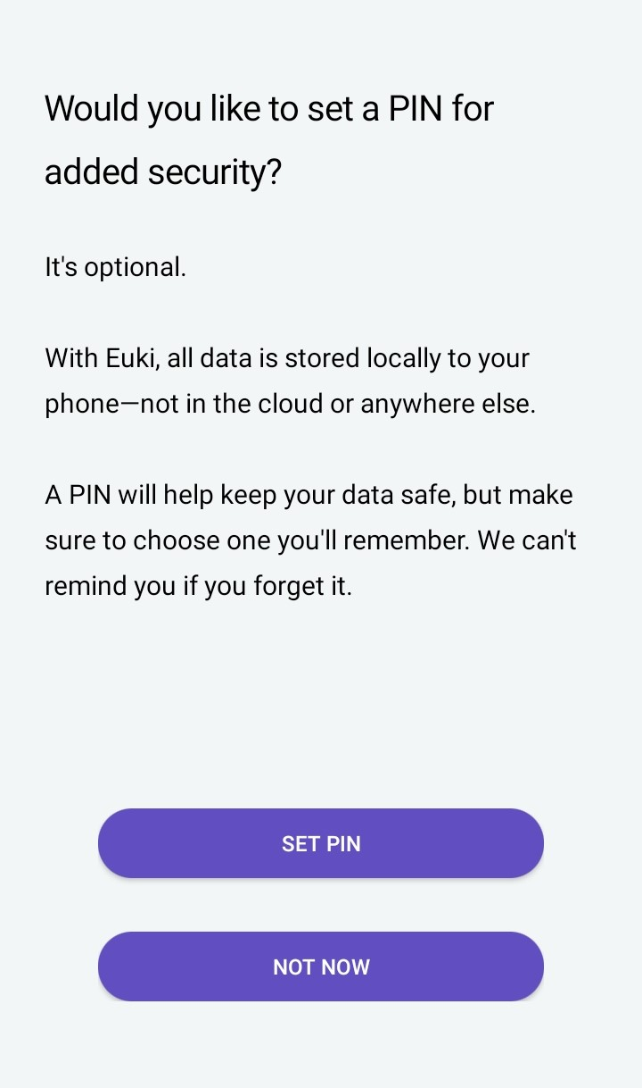
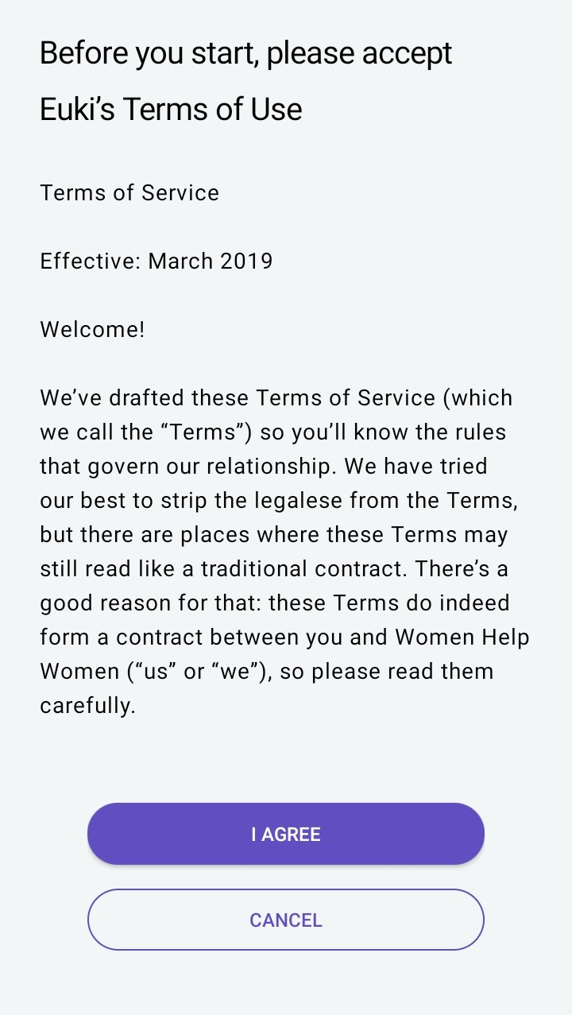
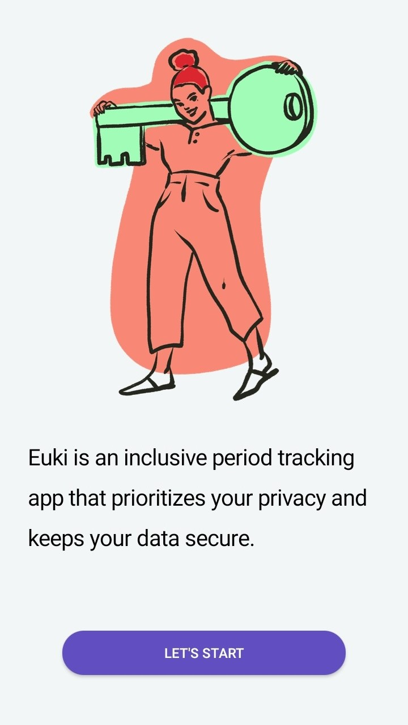
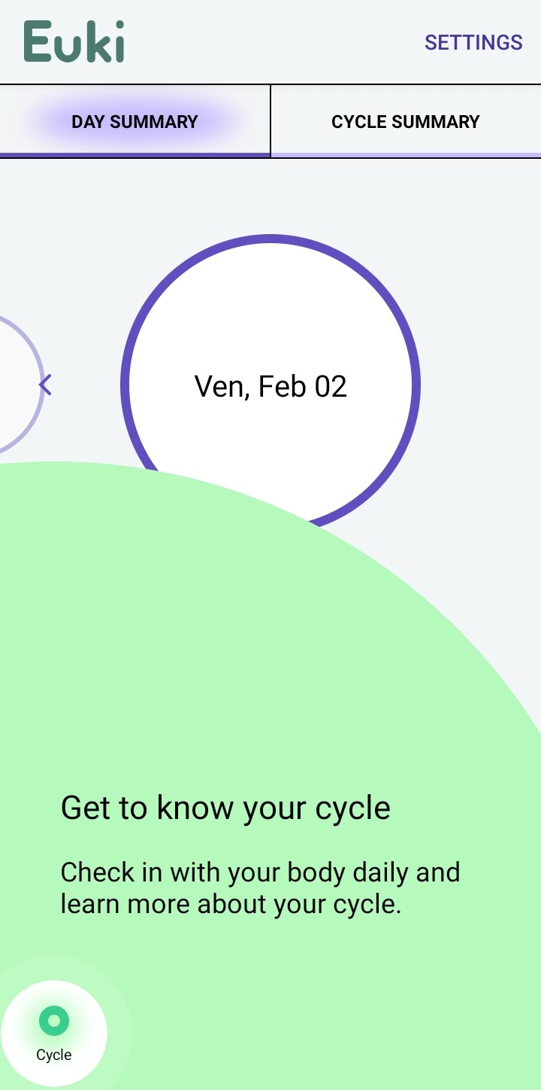



After clicking on the LET’S START button, deciding whether you want a PIN or not and agreeing on the terms of use you may start to track your period.
1
The image popping up when you open the app for the 1st time
2
3
You can also set a PIN to further protect your personal data

Slide 9
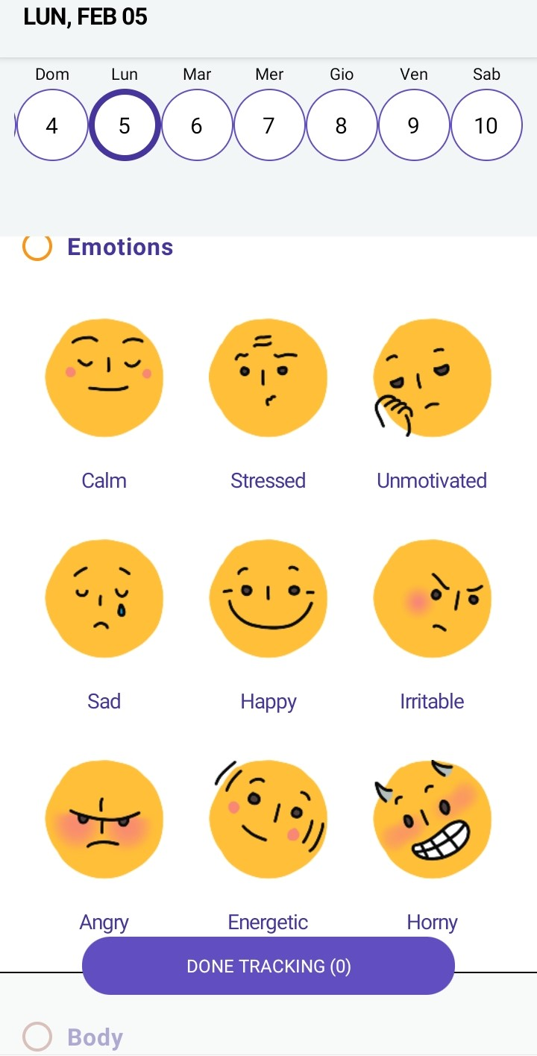
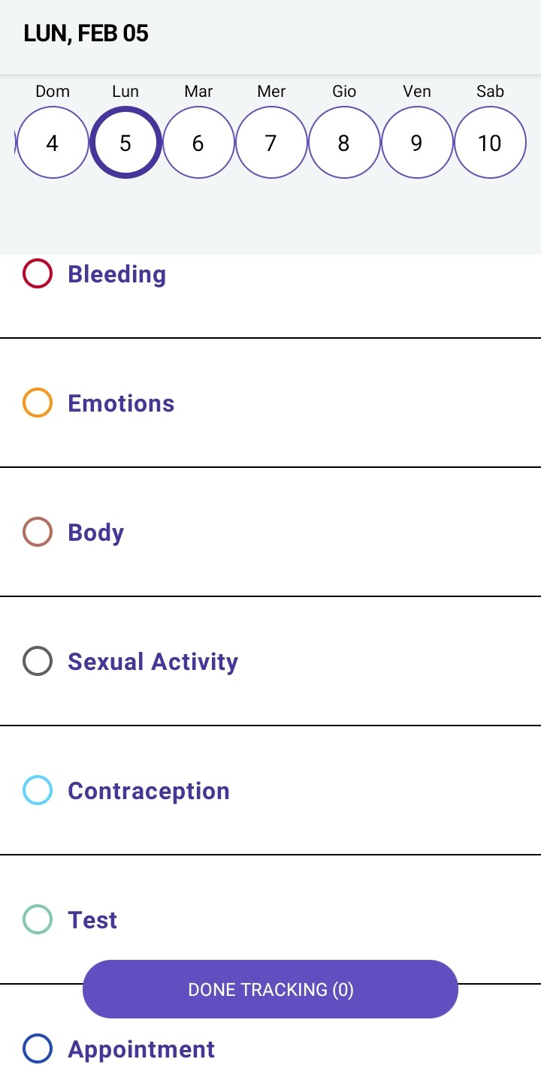

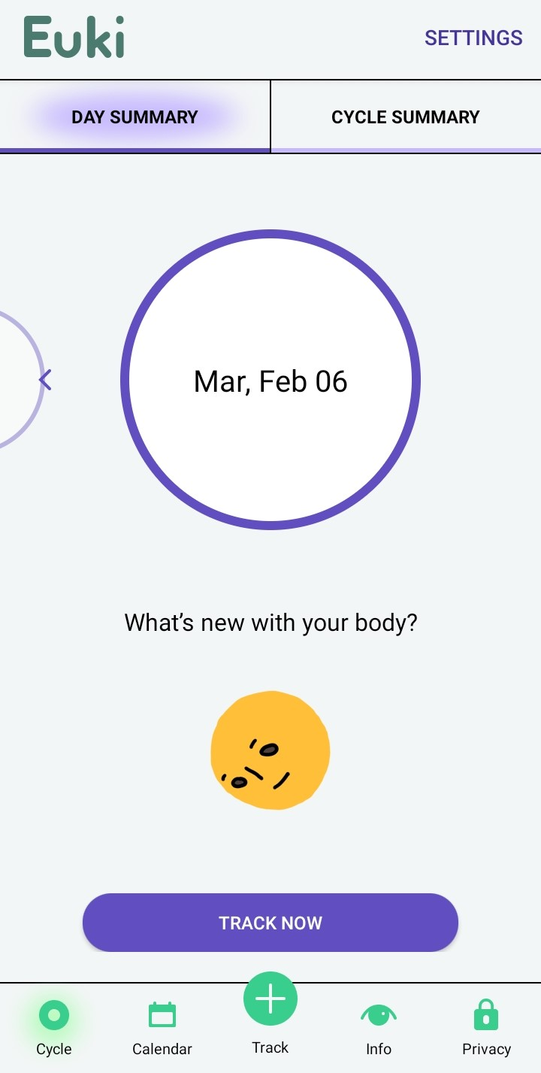
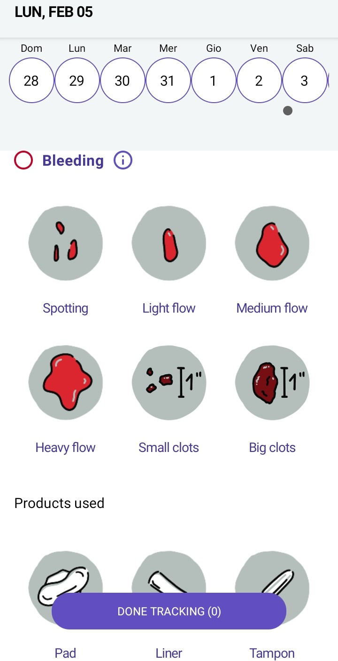
You can keep track of your menstruation and the products you use to cope with it.
Click on track now and you can start!
4
5
6
7
The app allows you to keep track of many different aspects of your reproductive health.
You can also track your emotions.

Slide 10
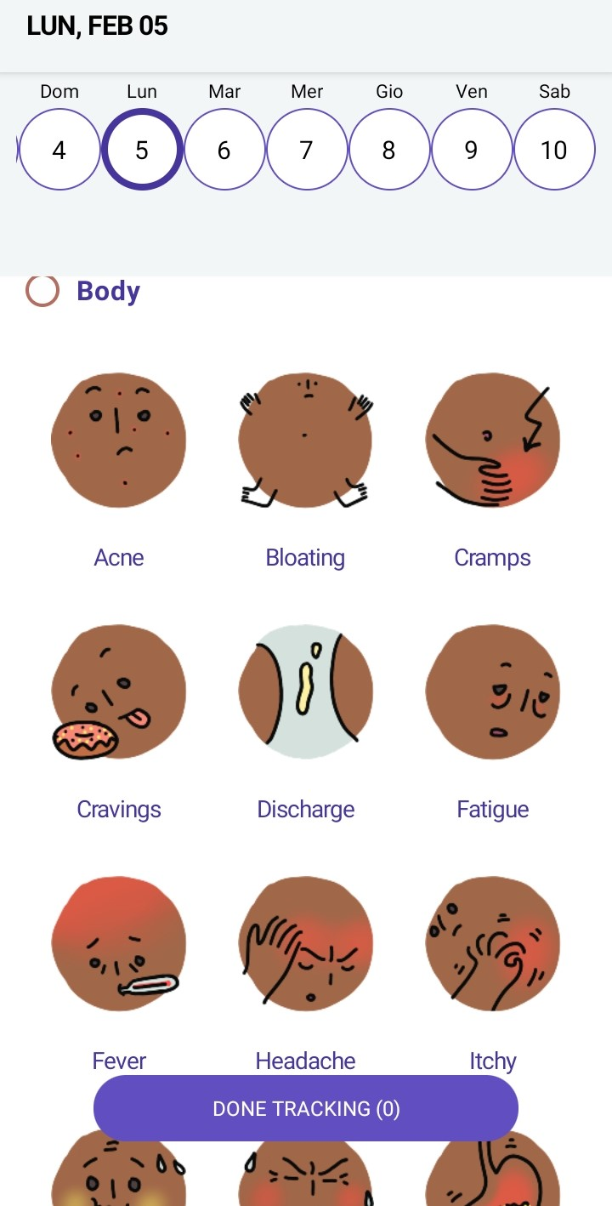
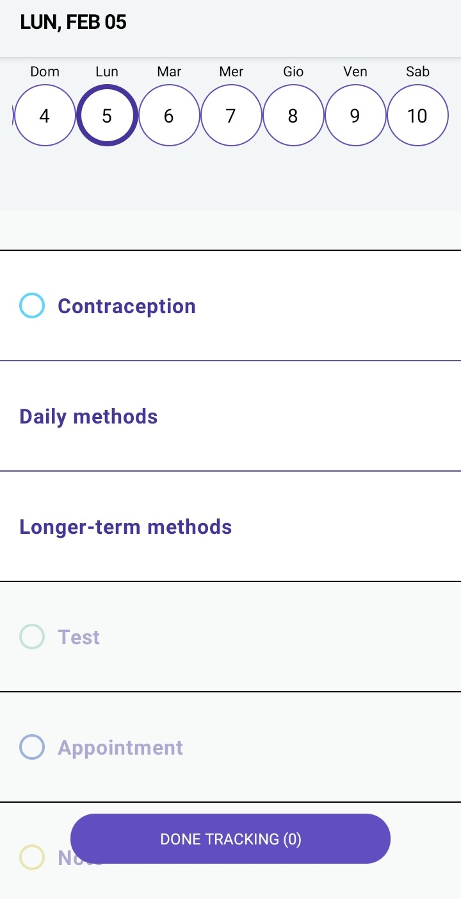
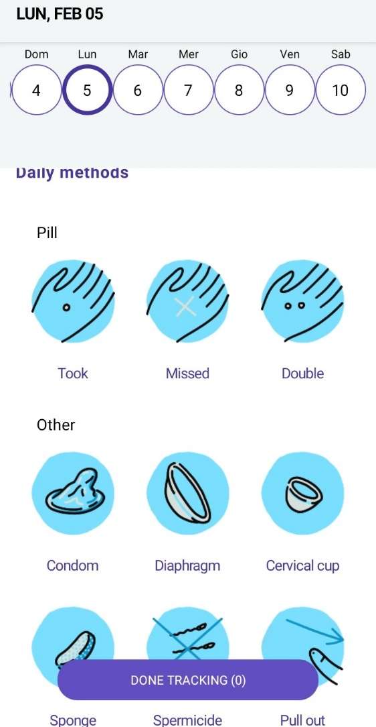

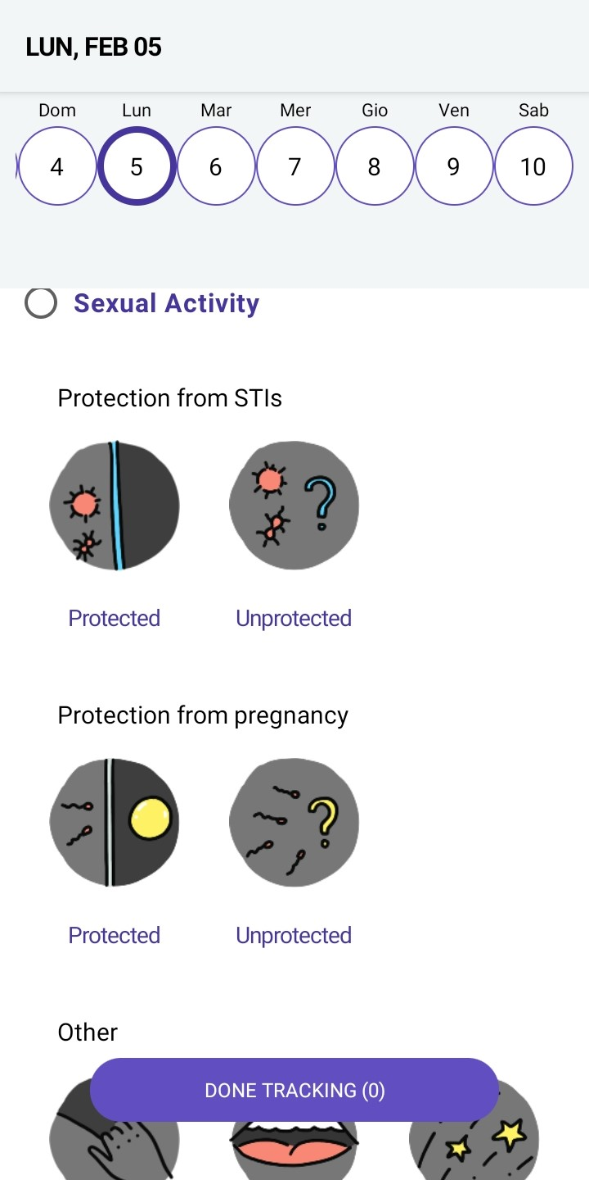
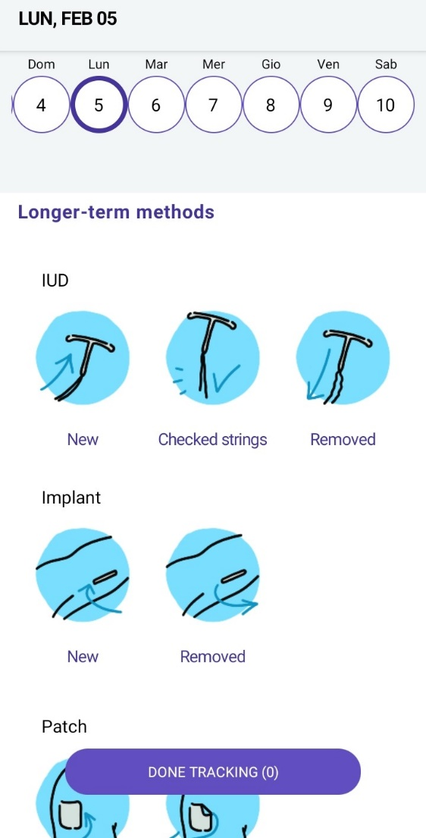


You can even track your sexual activity and various aspects related to it.
The app helps you track your contraceptive methods, including possible missed doses.
… and your PMS symptoms.

Slide 11
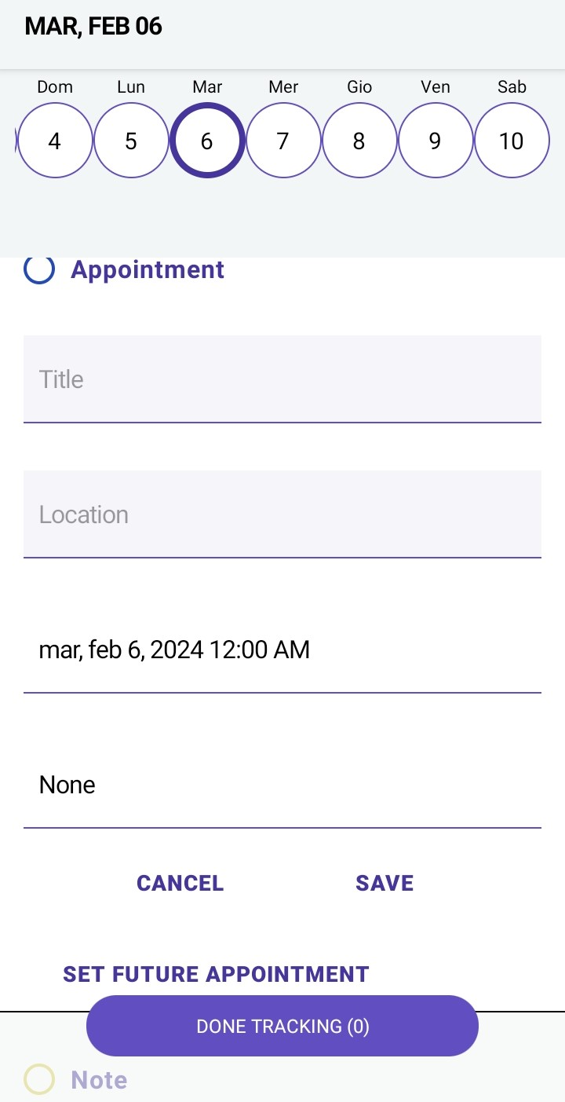

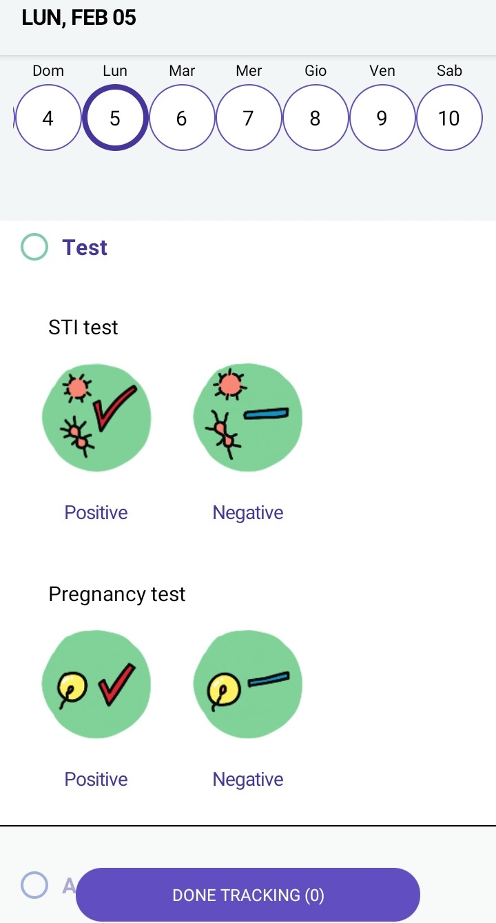
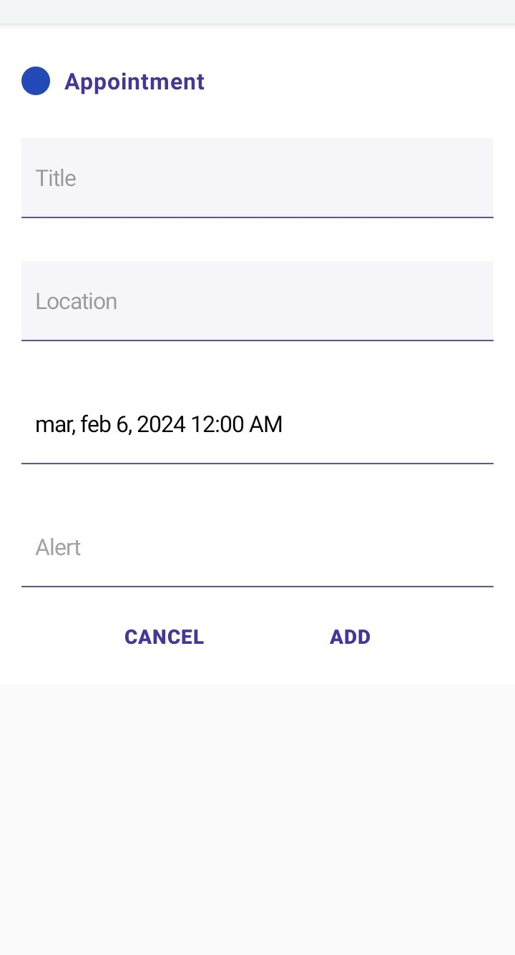
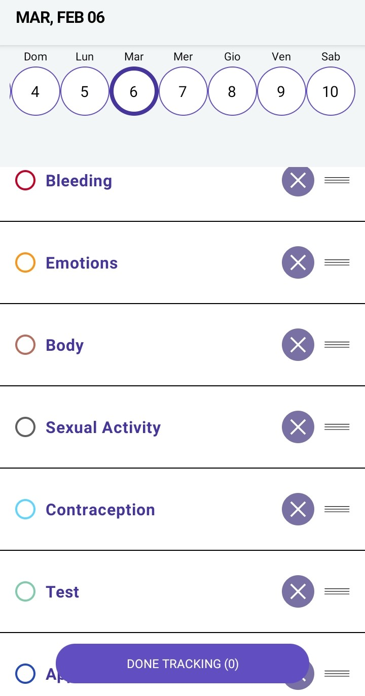

You can also track if and when you took a test to detect any sexually transmittable disease or a pregnancy test.
If you are not interested in tracking so many details you can decide to remove some features from the menu.
You can also track your appointments and set reminders for future ones.

Slide 12
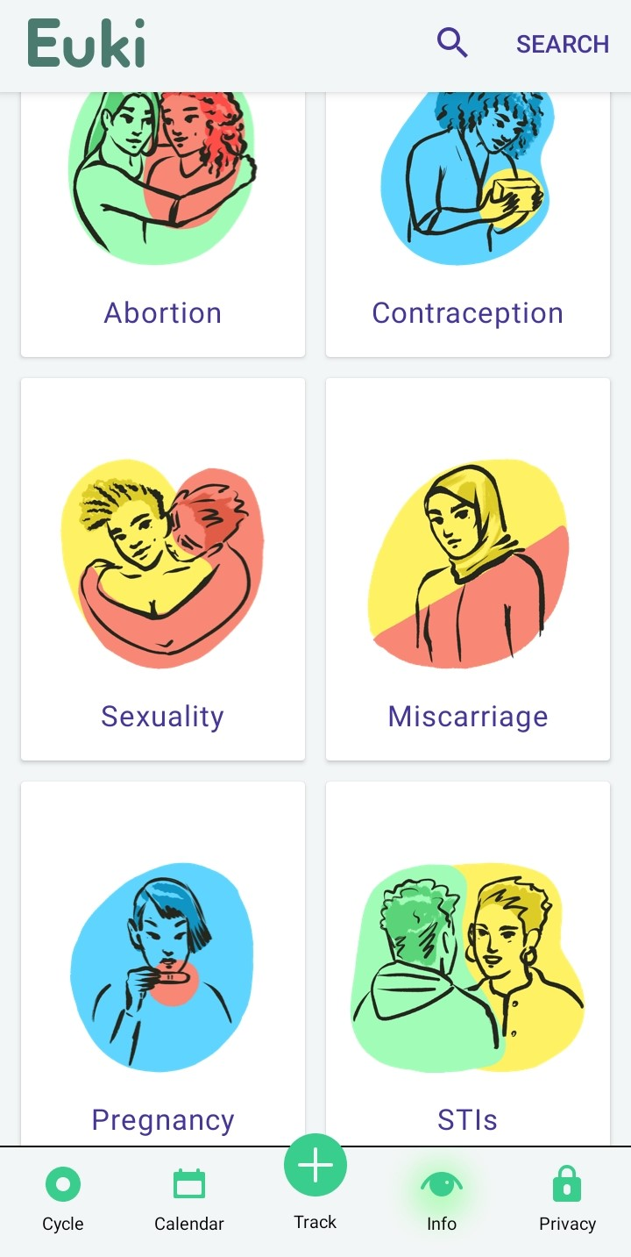
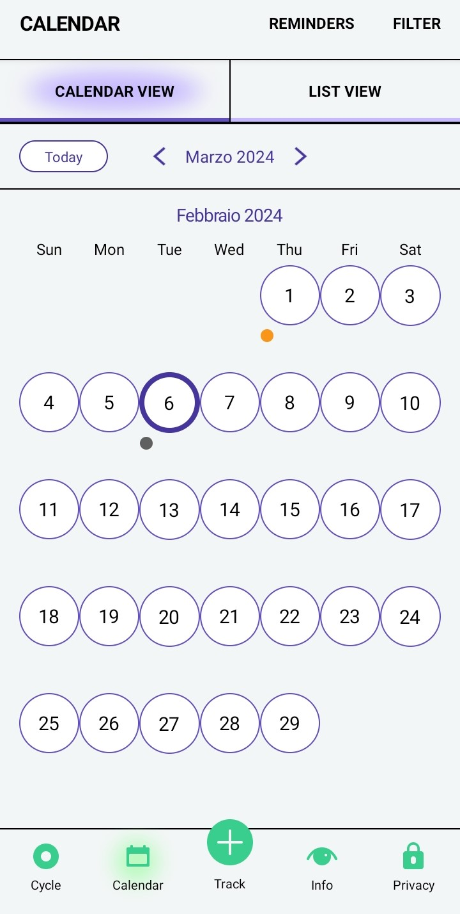
Dots in different colors, according to the aspect you decided to track, will appear under each day. By clicking on the day you can also see the details.
From the home page you can also access the calendar and a very rich information section

Slide 13

Example 2:
Know Your Lemons – Self Exam
App designed to improve early detection of breast cancer and period tracking. It’s free and doesn’t collect your data.
Main features:
#1 app for breast self exams;
Monthly reminders timed to your breast cycle;
Understanding your screening plan;
Information about risk factors, details about signs and symptoms, preparing for mammograms, and more.

Slide 14
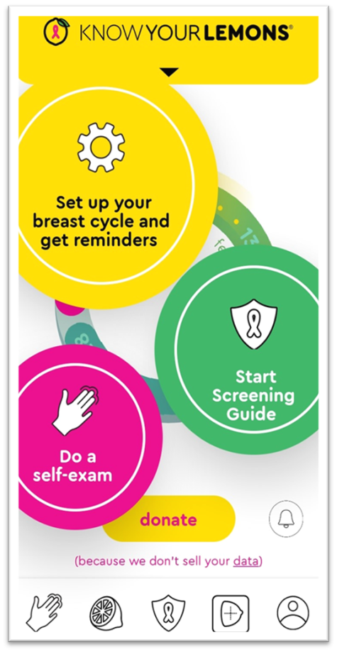
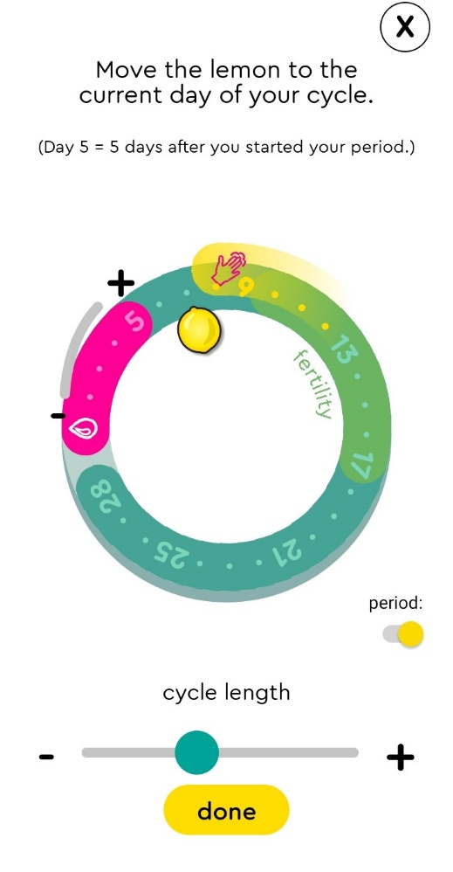

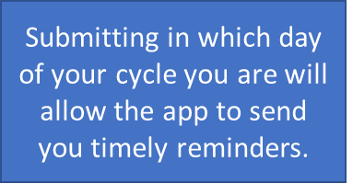

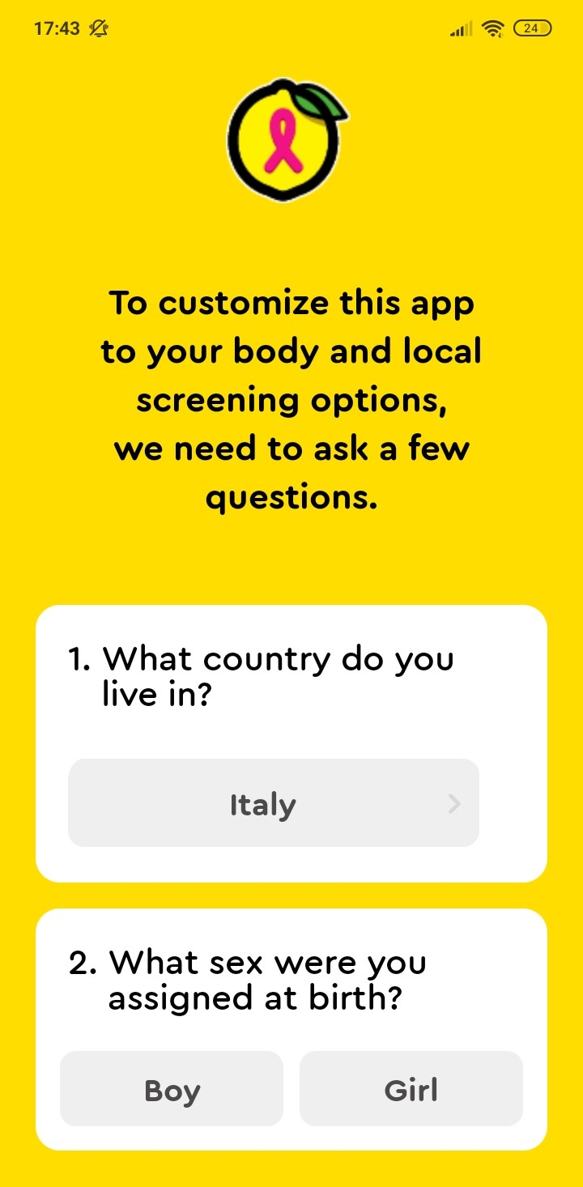


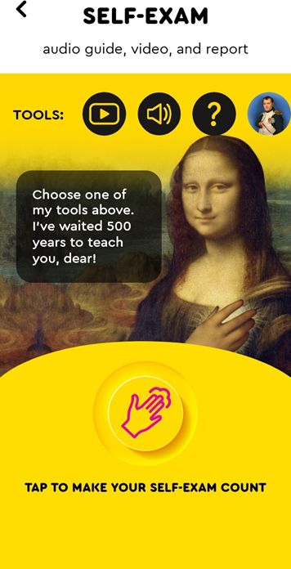
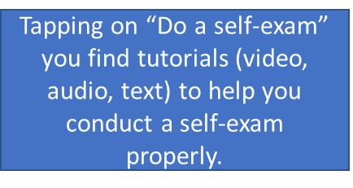


When you open the app for the 1st time, it will ask you brief questions to tailor the content to your personal situation.
After logging in with your username and an email address you can start using the app.

Slide 15
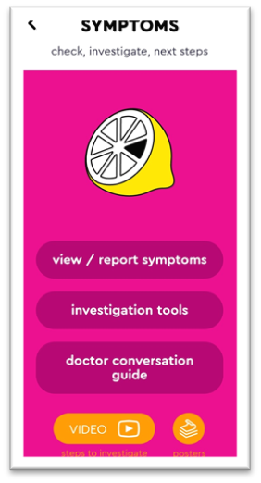
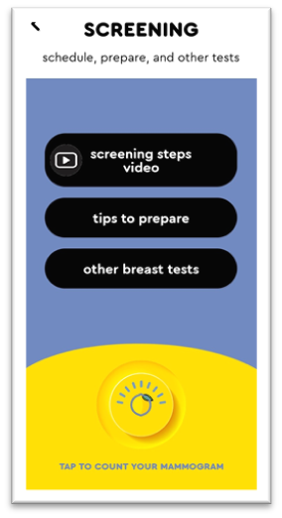
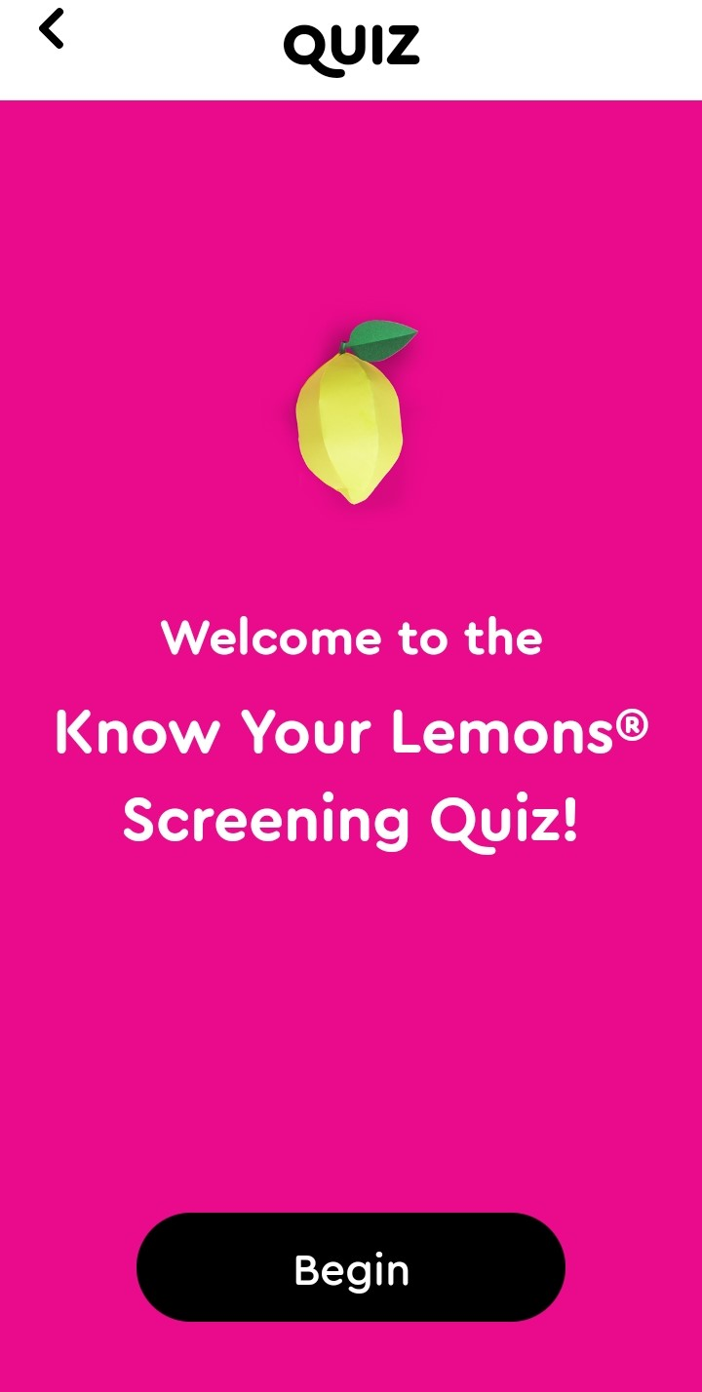
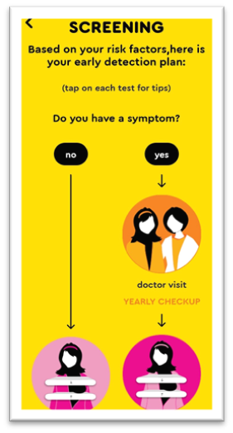

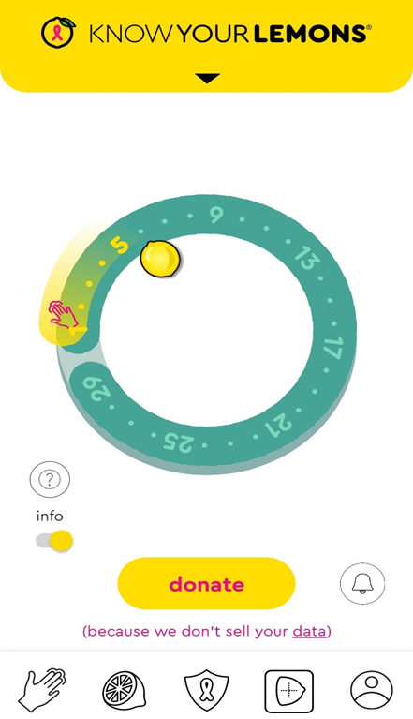


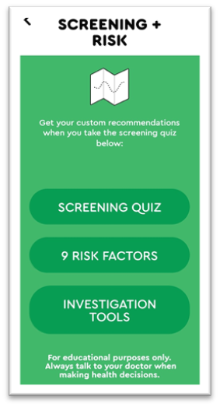
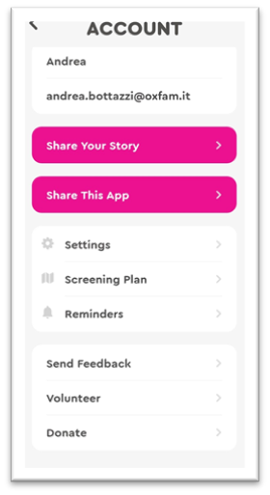




From the homepage you can always access the different sections: Self-exam, Symptoms (1); Risk factors and Familiarity (2); Screening (3) and Account (4)
2
Taking the quiz will help the app customise your personal screening guide.
Each section contains further information and suggestions.

Slide 16
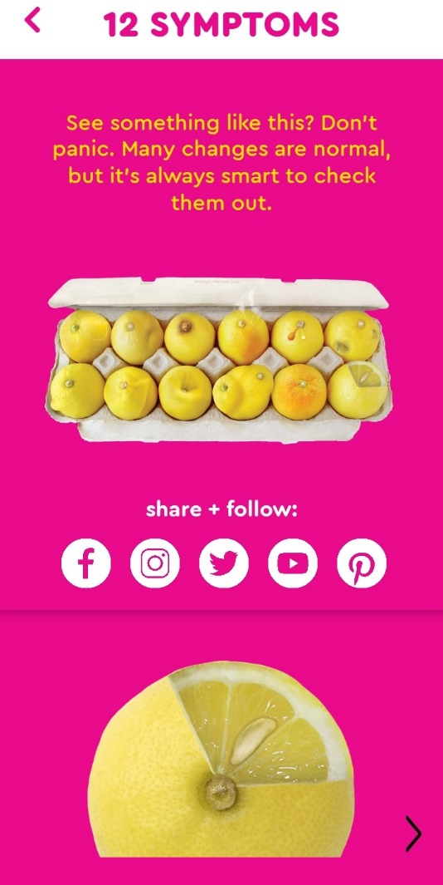
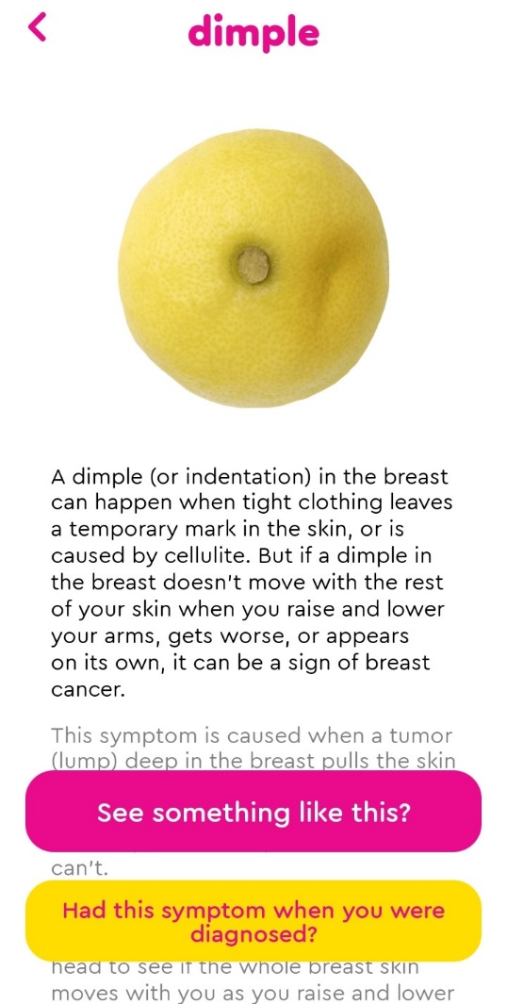

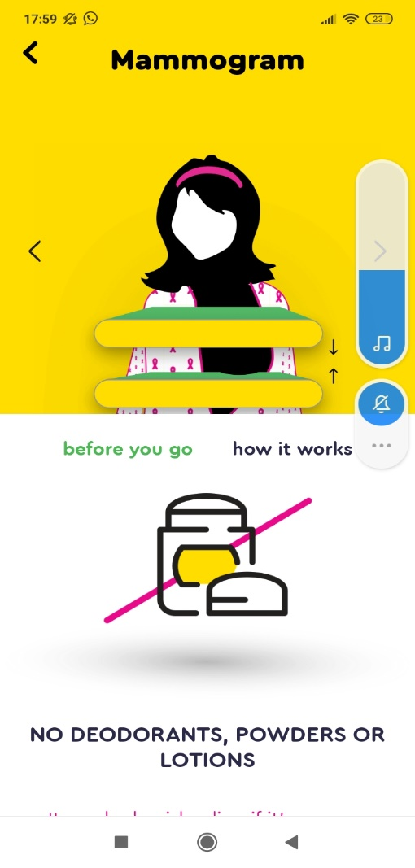
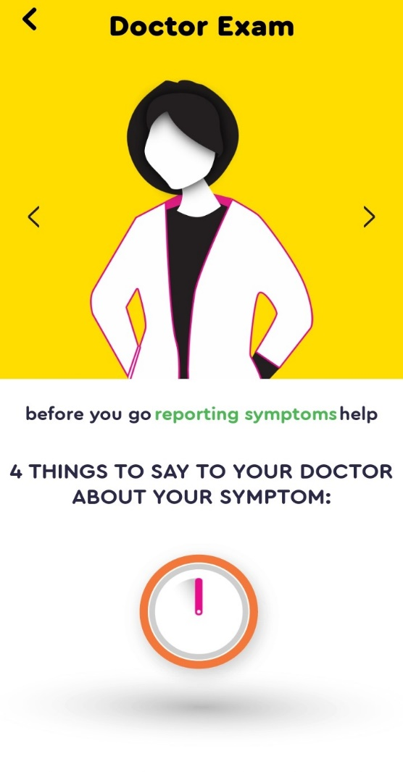
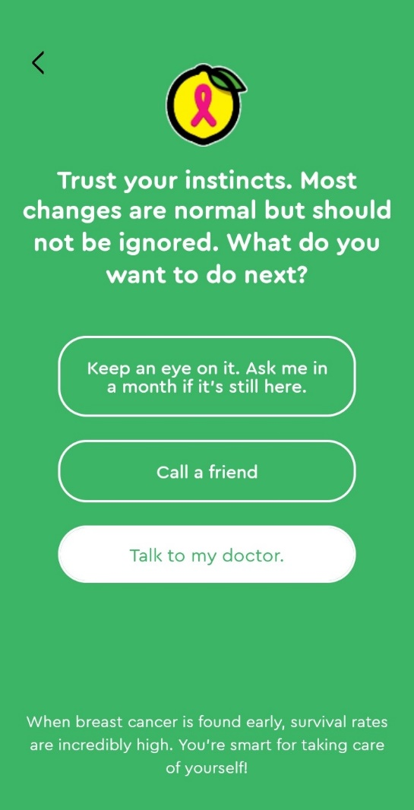
If you spot something during your self-exam the app can give you hints about Doctor Exam or further Screenings.
From the Symptoms section you will be able to acquire specific information.

Slide 17
7.2.2
Real life integrations
Objectives
To provide real-life scenarios of how health apps may help women’s health in general.
To present different real-life scenarios where women’s health apps could be beneficial.
Designed by Freepik

Slide 18
Scenario 1
Planning an important event
B. a 34-year-old woman and M. have been together for a very long time
They decide to get married and want to organise a big ceremony, inviting families and friends and want everything to be perfect. B. is afraid that her heavy menstrual flow might make the day more difficult. The ceremony is supposed to take place in a few months.
B. decides to download a menstrual cycle tracking app, in order to keep track of her period and decide which date fits best for the wedding.

Slide 19
Scenario 2
Cope with an unexpected situation
F. a 40-year-old woman has a friend who has just been diagnosed with breast cancer.
F. tends to be a slight hypocondriac and she’s very moved by this news. She starts having bad thoughts and she’s scared she might have breast cancer too.
Another friend suggests F. to download a self-examination app, that can help her conduct a self-exam, collect further information about breast cancer and its possible symptoms.

Slide 20
Scenario 3
Pregnancy
M. is a young mother-to-be, expecting her first child in a foreign country and she doesn’t speak the local language. Her partner is supportive but also inexperienced and struggling to speak the local language.
M. wishes to be as prepared as possible and to live a relaxed and happy pregnancy.
She downloads a pregnancy tracker app because she understands English and she can extract useful information from it.

Slide 21
Scenario 4
Menopause transition
R. is a 49-year-old woman transitioning into menopause.
R. experiences perimenopause cycle changes and would like to be able to predict her menstruation, as it used to be very regular.
She downloads a menopause app, which could help her predict her period based on her patterns.

Slide 22
Scenario X?
Suggestions?
Any other scenario in which a Women’s App could be useful?

Slide 23


Congratulations!
You have completed the experiential training session of this module!
Funded by the European Union. Views and opinions expressed are however those of the author(s) only and do not necessarily reflect those of the European Union or the European Education and Culture Executive Agency (EACEA). Neither the European Union nor EACEA can be held responsible for them.

