Slide 1





1
7
2
8
3
9
https://apps4health.eu/
4
Module 9 - Teaching session (9.1)
Health Apps for the Elderly
10
5
11
6
Funded by the European Union. Views and opinions expressed are however those of the author(s) only and do not necessarily reflect those of the European Union or the European Education and Culture Executive Agency (EACEA). Neither the European Union nor EACEA can be held responsible for them.

Slide 2
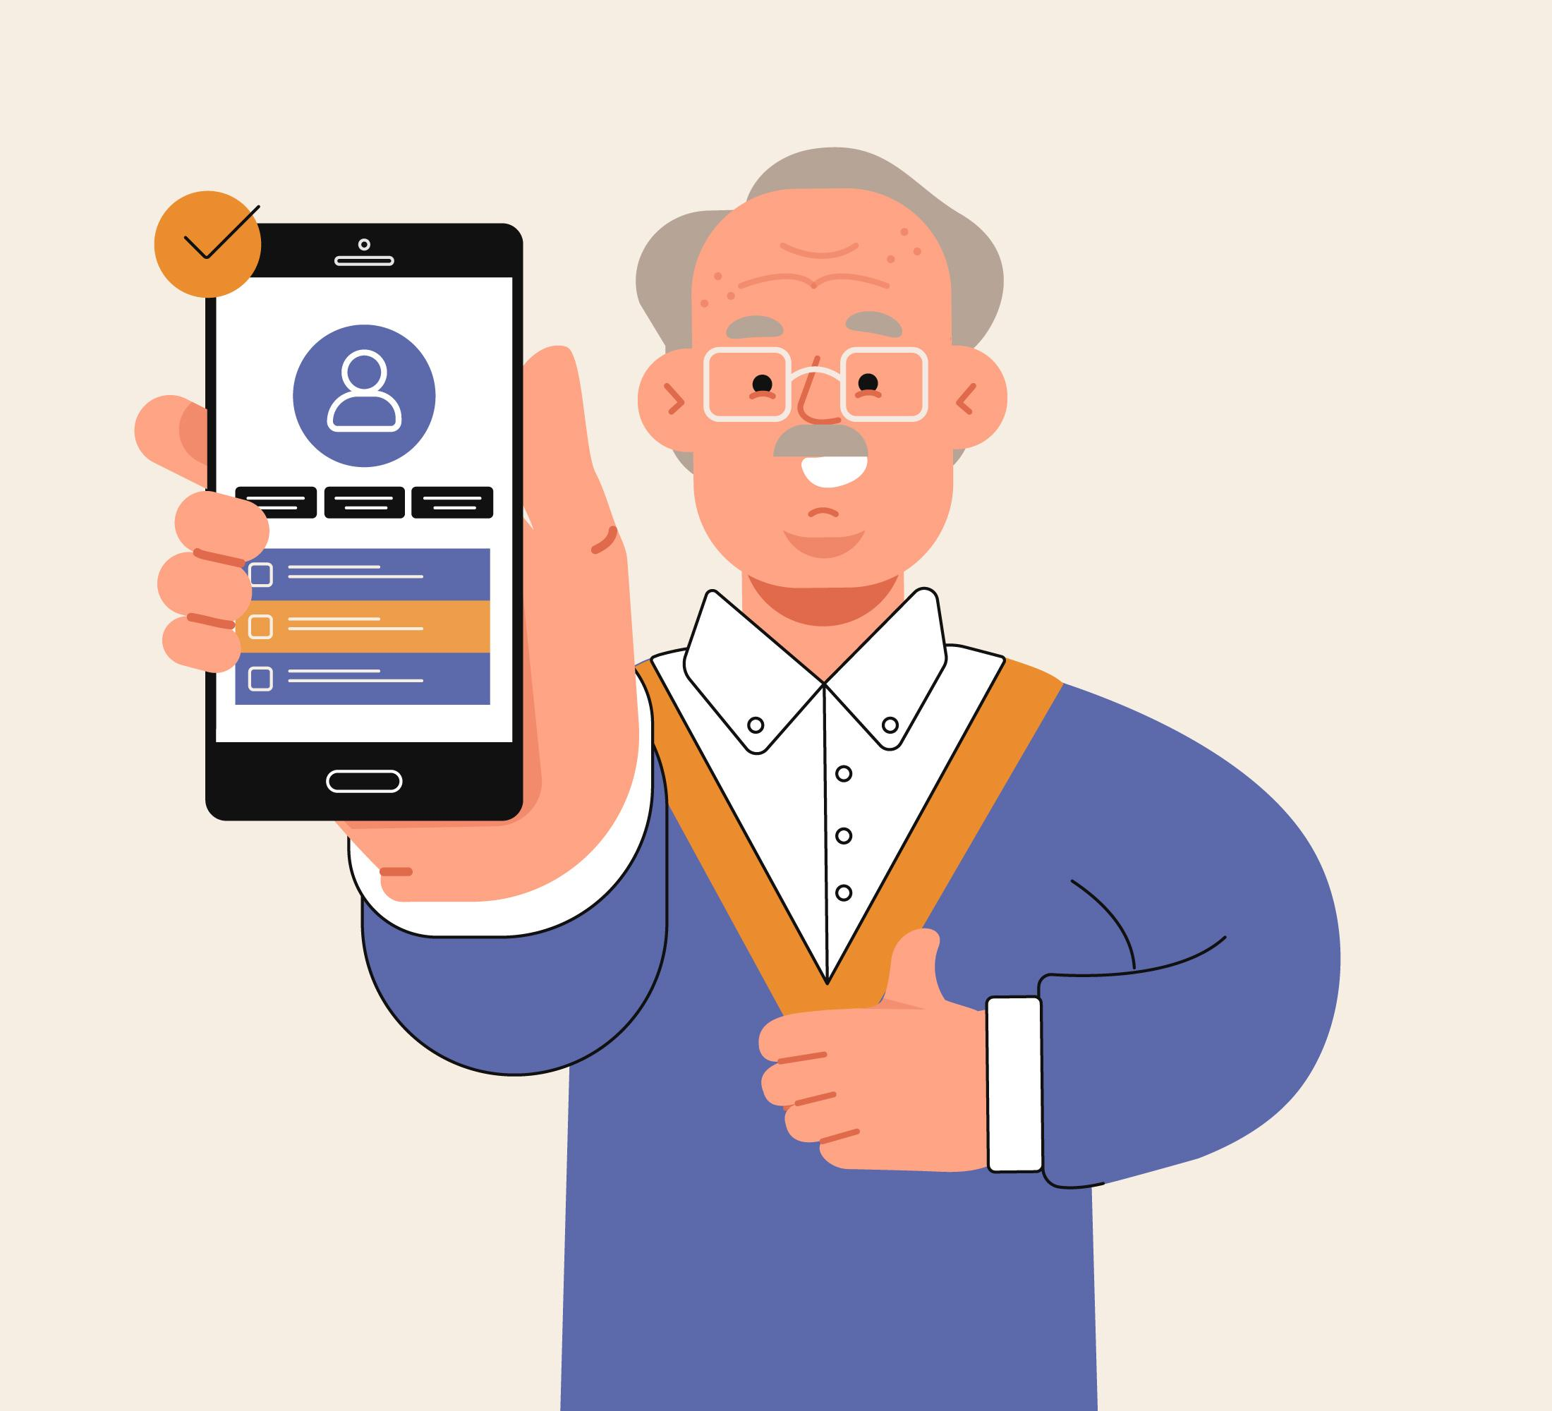
9
Health Apps for the Elderly

Slide 3











Partners
UNIVERSITAT DE VALENCIA
VALENCIA, SPAIN
www.uv.es
PROLEPSIS
ATHENS, GREECE
www.prolepsis.gr
WESTFALISCHE HOCHSCHULE GELSENKIRCHEN,
BOCHOLT, RECKLINGHAUSEN
GELSENKIRCHEN, GERMANY
www.w-hs.de
OXFAM ITALIA INTERCULTURA
AREZZO, ITALY
www.oxfamitalia.org/
CONNEXIONS
ATHENS, GREECE
www.connexions.gr
RESET
CYPRUS
www.resetcy.com
media k GmbH
Bad Mergentheim, GERMANY
www.media-k.eu
COORDINA ORGANIZACIÓN DE EMPRESAS Y
RECURSOS HUMANOS, S.L.
VALENCIA, SPAIN
coordina-oerh.com
AMSED
STRASBOURG, FRANCE
www.amsed.fr

Slide 4
Teaching Session: Content
1. General Information about ageing
2. Key areas of healthy ageing and activities of daily living
3. Health Apps for the Elderly and their benefits
4. Real-Life Integration Scenario
5. Navigating Apps and evaluating potential benefits
6. Discussion and Evaluation
7. Questions, next steps and Closure

Slide 5

Objectives
9
Health Apps for the Elderly – Teaching Session
To equip participants with the knowledge needed to identify relevant areas of healthy ageing and to make informed decisions about influencing ageing processes, regaining abilities or self-managing activities of daily living (ADL).
To equip participants with the knowledge required to use apps as valuable tools for healthy and active ageing.
Source: Image by nuraghies on Freepik

Slide 6
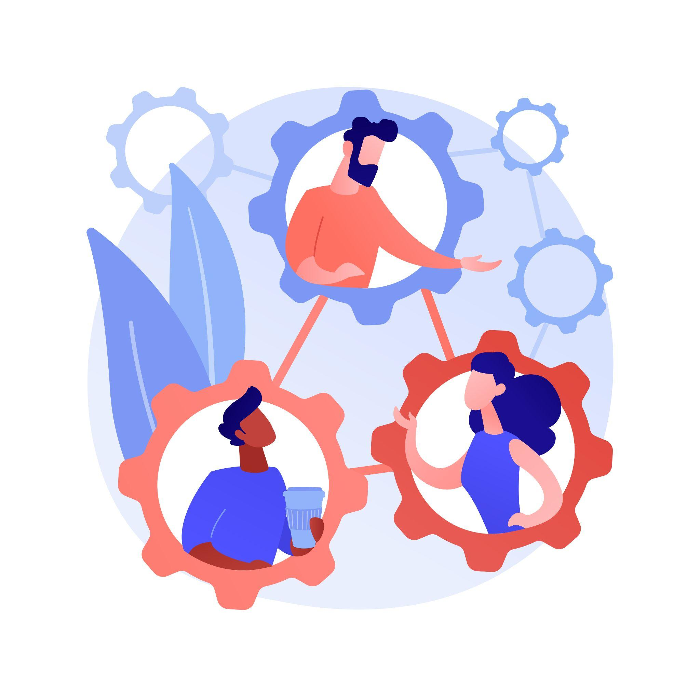
Competences
9
Health Apps for the Elderly – Teaching Session
Participants will be equipped with the skills to critically reflect their own lives or lives of loved ones to identify key areas of healthy ageing and to assess the potential of apps to address these.
Participants’ skills will be enhanced in order to make informed decisions about app selection, as well as to reflect barriers and facilitators to usage in everyday life, if they wish so.
Image by vectorjuice on Freepik

Slide 7

9.1.1
General Information about ageing
Objectives
To acquire general information about ageing processes.
To introduce factors influencing ageing.
To inform about the heterogeneity of ageing.
To understand concepts of (active and) healthy ageing.
Designed by Freepik

Slide 8

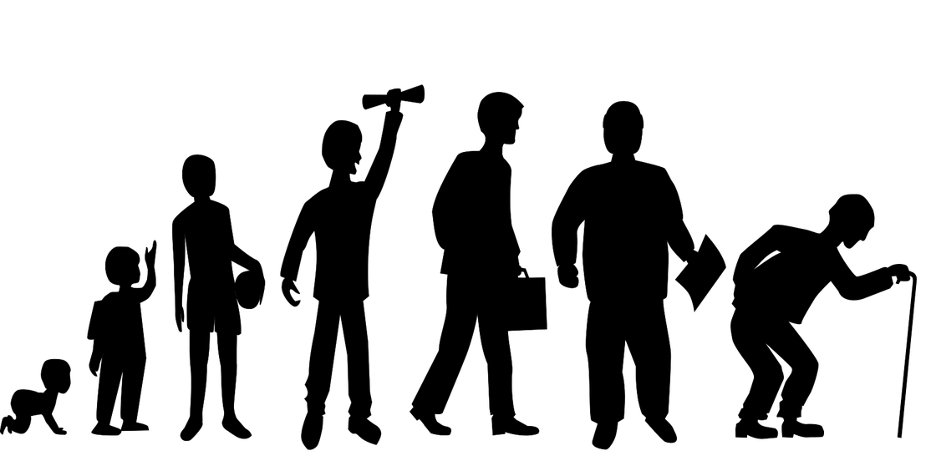
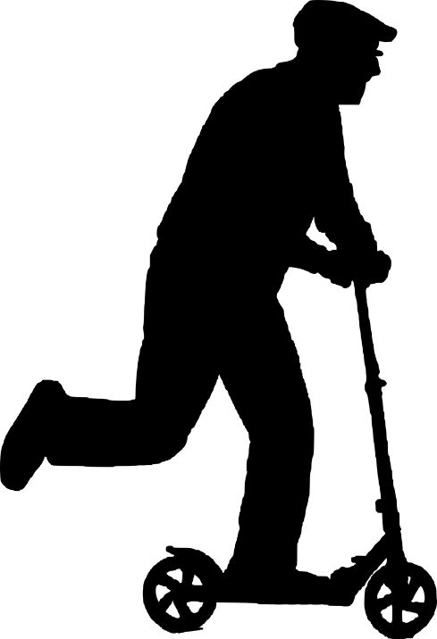
Activity 1: Icebreaker
What is ageing to you?
Who is an old perspn to you?
Please share your associations? Who and what do you think of?
How are older persons seen in your culture?
What do Apps have to do with it?
Source | Source | Pixabay license
Image by vectorjuice on Freepik

Slide 9

Who is an «older person» and what is ageing?
9.1.1 General nutrition knowledge
Who is regarded as an “older person” is in most western countries associated with the chronological age at which one receives pension benefits.
The United Nations defines an “older person” as being aged 60 – 65 years and older (UN DESA, 2020)
Who is regarded as an “older person” is also socially-constructed (changing social roles, e. g. becoming grandparents, leaving the workforce or change in physical characteristics, e. g. grey hair)
However, ageing is a complex process: “Ageing is associated with changes in dynamic biological, physiological, environmental, psychological, behavioral and social processes”. (NIA, 2020)
Source| Pixabay license
Notes:
UN DESA, 2020: https://www.un.org/en/development/desa/population/publications/pdf/ageing/WorldPopulationAgeing2019-Report.pdf
NIA, 2020: https://www.nia.nih.gov/about/aging-strategic-directions-research/understanding-dynamics-aging

Slide 10
So, what are ageing processes?
9.1.1 General nutrition knowledge
Ageing processes progress individually and are influenced by multiple factors, e. g. gender, ethnicity, genetic dispositions (e.g. increased likelihood to suffer from certain diseases), socio-economic status (education, e. g. level of health competencies), environments lived in (e. g. exposure to health risks, access to quality health care services, experiencing war, being displaced), life-style choices (e. g. substance usage, dietary habits, physical activity) over life courses.
All of these factors can lead to different processes and outcomes!
Source| Pixabay license
Notes:
Background info:
https://www.who.int/news-room/fact-sheets/detail/ageing-and-health
https://www.who.int/news-room/questions-and-answers/item/healthy-ageing-and-functional-ability

Slide 11
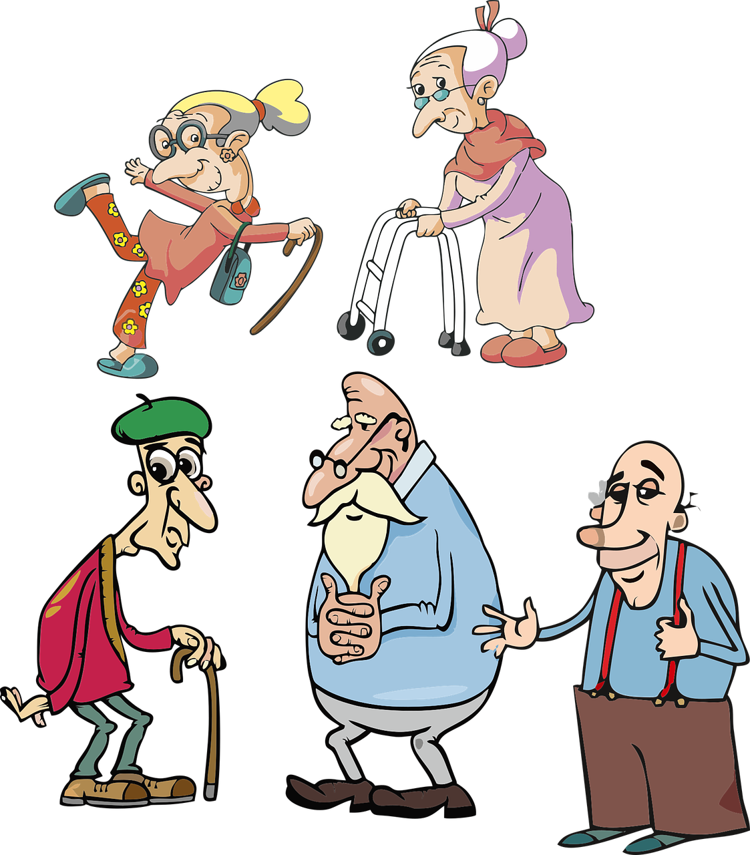
Stereotypes about “older persons”? No! Heterogenity of Ageing!
9.1.1 General nutrition knowledge
Ageing is often associated with different negative aspects: biologically (e. g. loss of physical and mental capabilities and mulitmorbidity), socially ( e.g. loss of social roles, loss of friends, isolation, being dependent or a burden)
Still, stereotypes about older people as simply “old, frail and a burden” are ageist and not appropriate!
Ageing processes are individual and can be influenced to some degree
Source| Pixabay license

Slide 12
Heterogenity of Ageing!
9.1.1 General nutrition knowledge
The heterogeneous ageing processes can lead to different levels of performance and everyday living conditions in old age, so that it may be more or less possible for older people to perform acitivities of daily living (ADL) in different areas of life.
“Some 80-year-olds have levels of physical and mental capacity that compare favourably with 30-year-olds. Others of the same age may require extensive care and support for basic activities like dressing and eating.” (WHO, 2020)
  Older persons are divers in health and in their levels of functional ability.
  As shown, some factors of ageing can be influenced over the life course and some can be addressed in old age to keep functional ability.
Source| Pixabay license
Notes:
WHO, 2020: https://www.who.int/news-room/questions-and-answers/item/healthy-ageing-and-functional-ability

Slide 13
Healthy Ageing
9.1.1 General nutrition knowledge
Healthy ageing is regarded as:
“the process of developing and maintaining the functional ability that enables wellbeing in older age.” (WHO, 2020)
“a continuous process of optimizing opportunities to maintain and improve physical and mental health, independence, and quality of life throughout the life course” (PAHO/WHO, 2024)
Healthy ageing should also empower people and needs reflection by the individual:
“the core of Active and Healthy Ageing is the awareness regarding the subjective nature of what is considered healthy and active ageing, meaning that the older adult themselves should have both autonomy and independence in defining their interpretation [7,8]. Thus, the primary goal is to support the empowerment of older adult persons in independently caring for their health [9].” (Marcussen/Marinus, 2021)
Notes:
WHO, 2020: https://www.who.int/news-room/questions-and-answers/item/healthy-ageing-and-functional-ability
PAHO/WHO, 2024: https://www.paho.org/en/healthy-aging

Slide 14
9.1.2
Functional ability, key areas of healthy ageing, activities of daily living (ADL)
Objectives
To acquire knowledge on the main concepts of healthy ageing.
To be empowered and able to reflect what areas could be addressed to maintain and improve health, independence and quality of life in old age.
Designed by Freepik

Slide 15
Functional ability Key areas of healthy ageing
9.1.2 Functional ability, key areas of …
Functional ability is about having the capabilities that enable all people to be and do what they have reason to value. This includes a persons ability to:
Meet their basic needs
Learn, grow and make decisions
Be mobile
Contribute to society
(WHO, 2020)
Meeting basic needs and making decisions can be of value in several dimensions of daily life. Succesfully doing this, can affect ageing processes in a variety of ways.
Imporant key areas in this regard are:
Cognitive activities
Physical activities
Social engagement
Mental Health
Chronic disease and disabilities
Other Acitivities of daily living (ADL)
Notes:
WHO, 2020: https://www.who.int/news-room/questions-and-answers/item/healthy-ageing-and-functional-ability

Slide 16
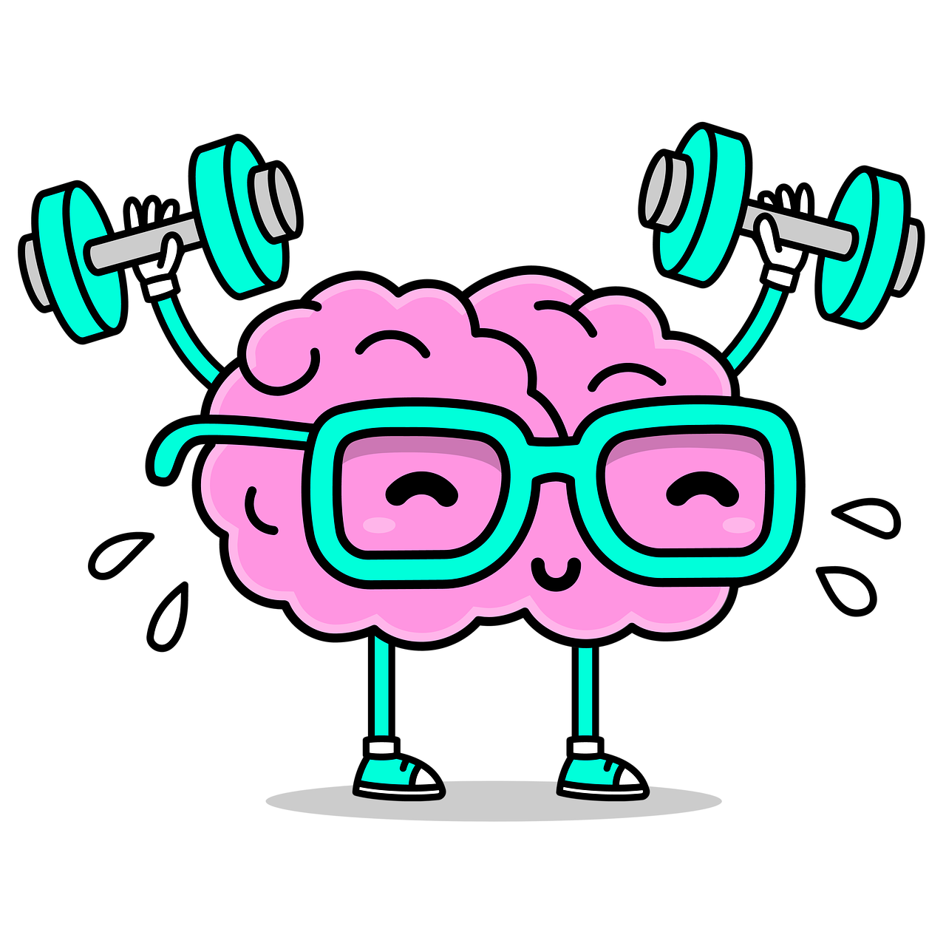
Cognitive Activities
9.1.2 Functional ability, key areas of …
Studies have shown that training brain fitness can greatly improve your memory and reduce the risk of neurological diseases like dementia.
You can do that by seeking new challenges which excite you and bring joy to your life like for example …
Learning something new like an instrument, or a language you were always interested in
Learning a craft you are passionate about you never found the time to like woodwork, painting or pottery
Training your Computer skills by enganging with software you are interested in for example by learning to use photo editing programs
Playing challenging cognitive games (e.g. chess or memory games)
Source| Pixabay license

Slide 17
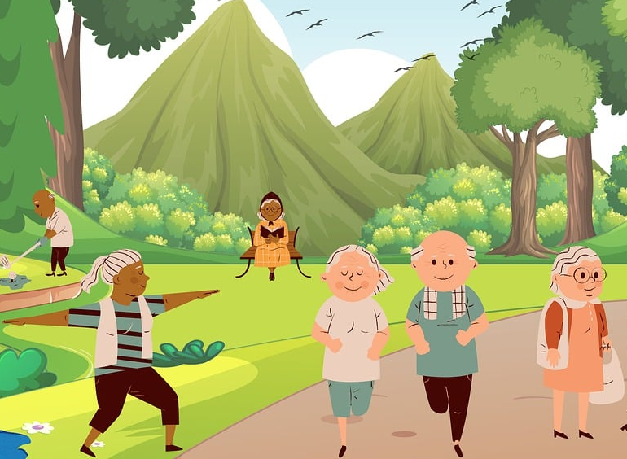
Physical Activities
9.1.2 Functional ability, key areas of …
Engaging in physical activities can help to stay mobile and independent
Engage in general physical activities depending on one‘s own level (e.g. going for walks, riding your bike, weight lifting, dancing)
Engage in activities of physical therapy (e.g. stretching, yoga or focused activities for individual problematic areas like knee joints or hip strengthening)
Source| Pixabay license

Slide 18
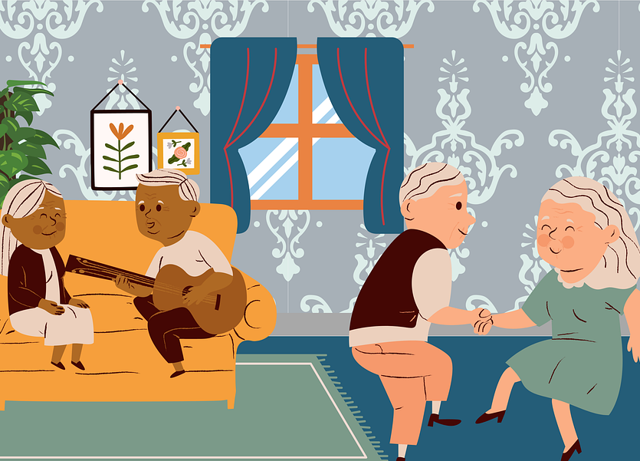
Social Engagement
9.1.2 Functional ability, key areas of …
Social engagement gives meaning to our lives and strengthens our relationship with others.
Stay in touch and interact regularly with friends and family – even with those who live far away
Join music clubs and cultural programs
Join an education centre and enrich others with your knowledge by offering classes in something you are good at for example in the field of your former work or in using smart phones and apps
Source| Pixabay license

Slide 19
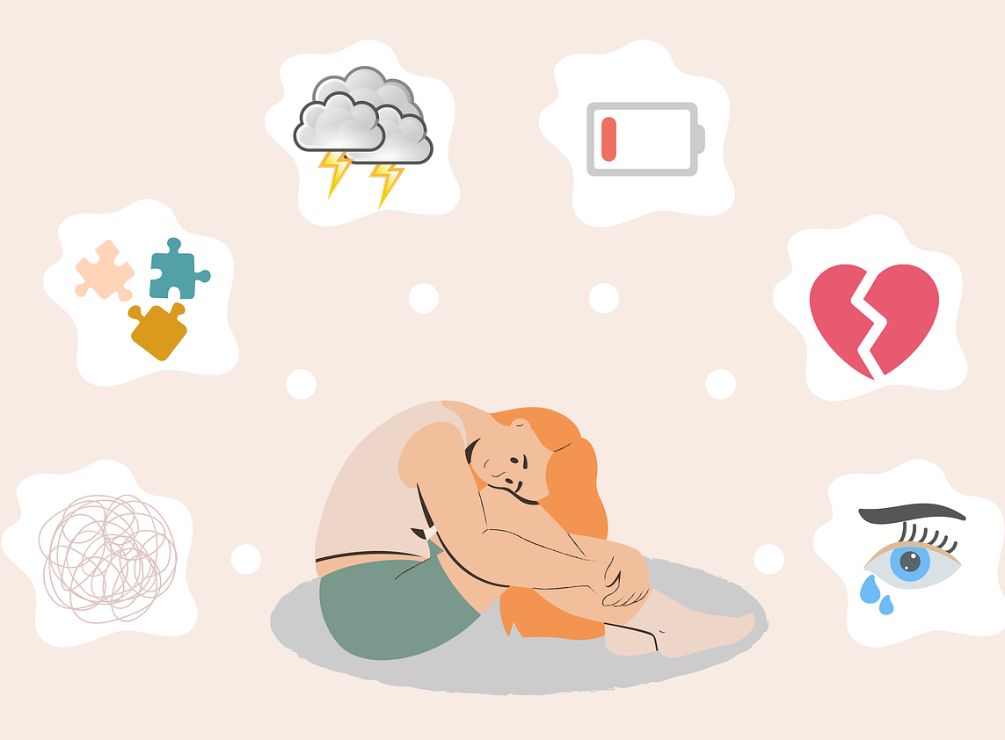
Mental Health
9.1.2 Functional ability, key areas of …
Emotional wellness plays an important factor throughout the life-course. However, dealing with declines in health, loss of social positions, loved ones or friends can increase with age. Thus, dealing with anxiety, emotional distress, anger or social isolation can become bothersome.
Being empowered to learn, manage and actively influence your mental health can help overcome negative feelings and boost emotional well-being. You can engage in…
Learning about mental health and your own mental health, e. g. keeping diaries to foster reflection, self-esteem and mindfulness
Therapy and self-help-groups
Meditation, breathing techniques, relaxation techniques
Source| Pixabay license

Slide 20

Chronic Disease and Disabilities
9.1.2 Functional ability, key areas of …
With increasing age the prevalence of chronic health conditions and reduced mobility is growing.
To stay in good shape, mobile and independent it‘s all the more important to keep negative consequences of such conditions in check, for example by …
Keeping track of your blood sugar level when facing diabetes
Regularly measuring your blood pressure level when issues with your cardiovascular system occur
Finding your way around in the neighborhood in case of dementia
Keeping track of your own medication intake
Source| Pixabay license

Slide 21
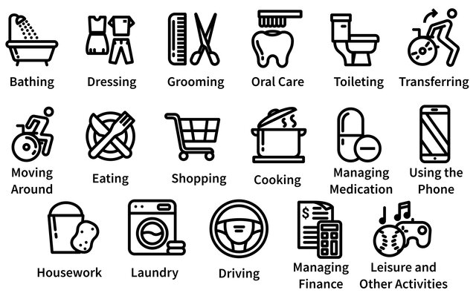
Activities of daily living (ADL)
9.1.2 Functional ability, key areas of …
Completing tasks of daily living by your own and being able to following your routines is a good way of staying in touch with your needs and experience self-efficacy. Also it‘s a strong indicator for good cognitive and physical health.
Maintain your daily routines of when to get up and when to go to bed to get restful and healthy sleep and being energized in the morning
Organizing mobility
Do the shopping for groceries on your own
Cook and prepare your own healthy meals
See the doctor regularly
Keeping track of your appointments and finances
Source| CC license

Slide 22

Activity 2: Reflection exercise
9.1.2 Functional ability, key areas of …
Now it‘s your turn!
What areas of healthy aging are the most important to you or your elderly loved ones ?
What are the most common difficulties you/they have faced in that area?
What are possibilities to maintain functional ability in that area?
Take a minute to reflect and take individual notes for a later discussion
Source| Pixabay license
Image by vectorjuice on Freepik

Slide 23
9.1.3
Health Apps for the Elderly and their benefits
Objectives
To acquire knowledge on common characteristics of Health Apps
To be able to develop ideas about how Health Apps could help to maintain and improve health, independence and quality of life in old age.
Designed by Freepik

Slide 24

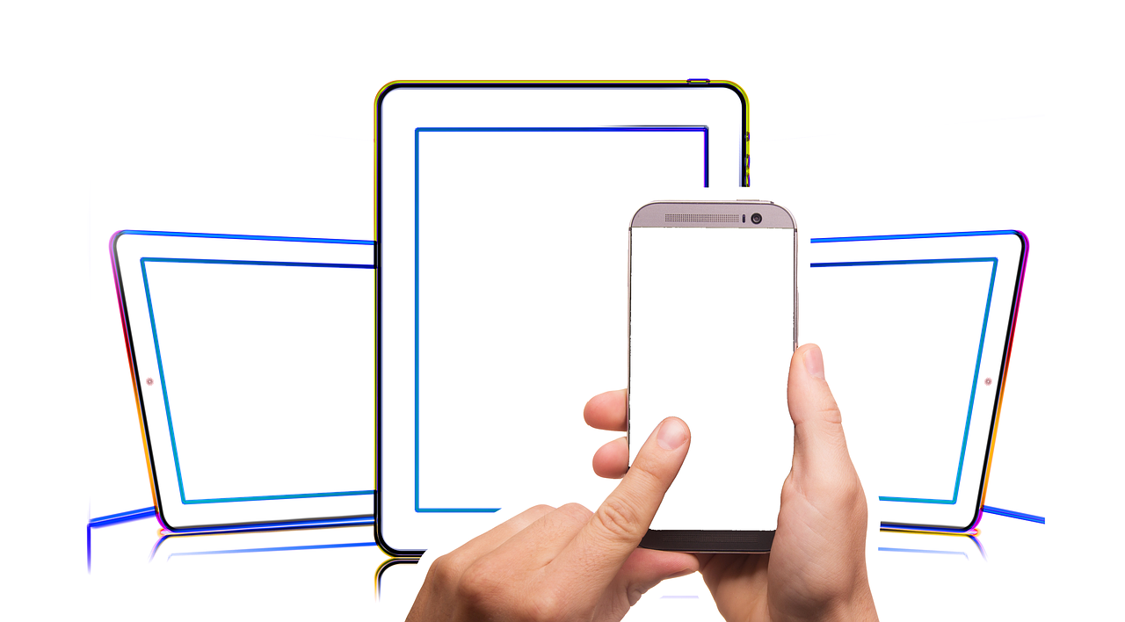
Health Apps and healthy ageing
9.1.3 Health Apps for the Elderly
There are plenty of health apps available for the elderly. Some are adressing the physical and mental fitness of its users while others have a clear medical implication with the purpose of managing a chronic illness or disability.
Health apps can help maintain or regain functional ability in the aforementioned key areas.
Source|Source| Pixabay license

Slide 25
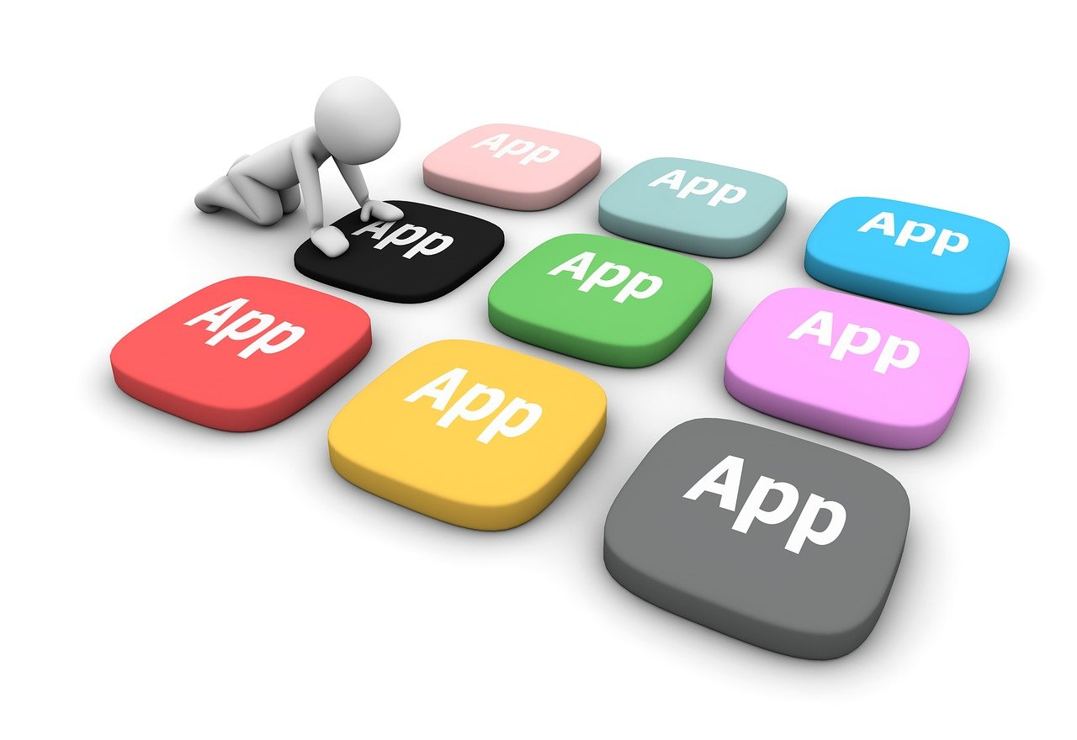
How can Health Apps contribute to Healthy Ageing?
9.1.3 Health Apps for the Elderly
Most of the available apps share the same basic functions to help increase functional ability in the key areas of healthy ageing.
Self monitoring/tracking
Goal setting
Cues or push notifications
Social support
Source| Pixabay license

Slide 26

Self monitoring and tracking
9.1.3 Health Apps for the Elderly
Self monitoring/tracking
Keep track of your symptoms or vital parameters so you can intervene at an early stage and prevent your condition from worsening
Improve your awareness what benefits your symptoms and overall well-being by checking with you symptom diary and reflect on what you did differently that day
Keep track of your progress when for example using an app to track your activities or workouts
Source| Pixabay license

Slide 27
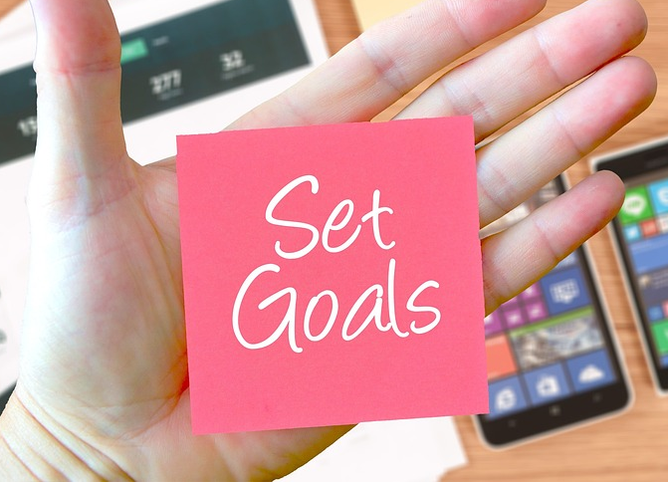
Goal setting
9.1.3 Health Apps for the Elderly
Set goals in your app on what you want to achieve that day – for example on the amount of steps you wanted to take to improve and maintain your physical fitness
Beat your high score and become more ambitious
Track your progress over a long period of time
Stay motivated to engage with the app regularly
Source| Pixabay license

Slide 28

Cues or push notifications
9.1.3 Health Apps for the Elderly
Be reminded of what you wanted to achieve the day so you‘ll be aware of it and integrate it into your daily routine
For example, be notified of when to take your next medication
See when it‘s time for your next checkup at the doctor‘s office so you will make your appointement
Be informed when health parameters when tracking a chronic disease change so you can get in touch with your health professional and check whether medications need to be adjusted
Source|Source| Pixabay license

Slide 29
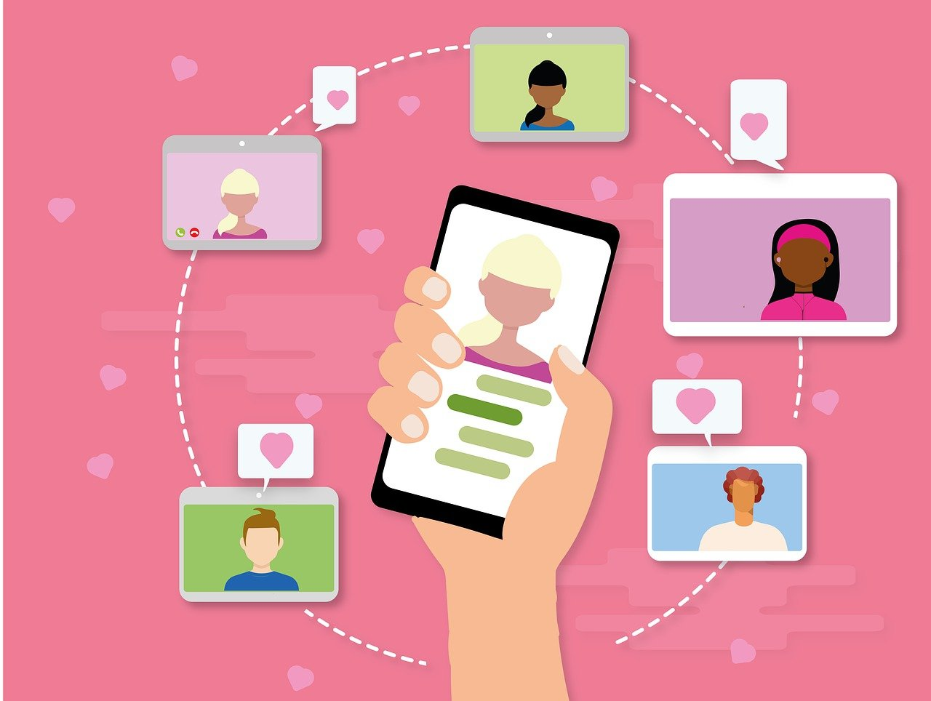
Social support
9.1.3 Health Apps for the Elderly
Stay in touch with friends and family
Share your progress with others for example when using an activity tracker or an app for work outs, running and other sports
Share important data and news with your friends and family (e. g. for medication intake or health care appointments)
Get feedback from others
Source| Pixabay license

Slide 30

Activity 3: Please share your experiences
9.1.3 Health Apps for the Elderly
Now it’s your turn!
If you have already used health apps in the past, what experience have you made and how did it help you if at all?
Discuss with the group!
Image by vectorjuice on Freepik
Source| Pixabay license

Slide 31
9.1.4
Real-Life integration scenario
Objectives
To be able to identify problems in ADL
To learn about benefits of one App for healthy ageing
To be able to identify support measures for usage of Health Apps to regain functional ability
Designed by Freepik

Slide 32
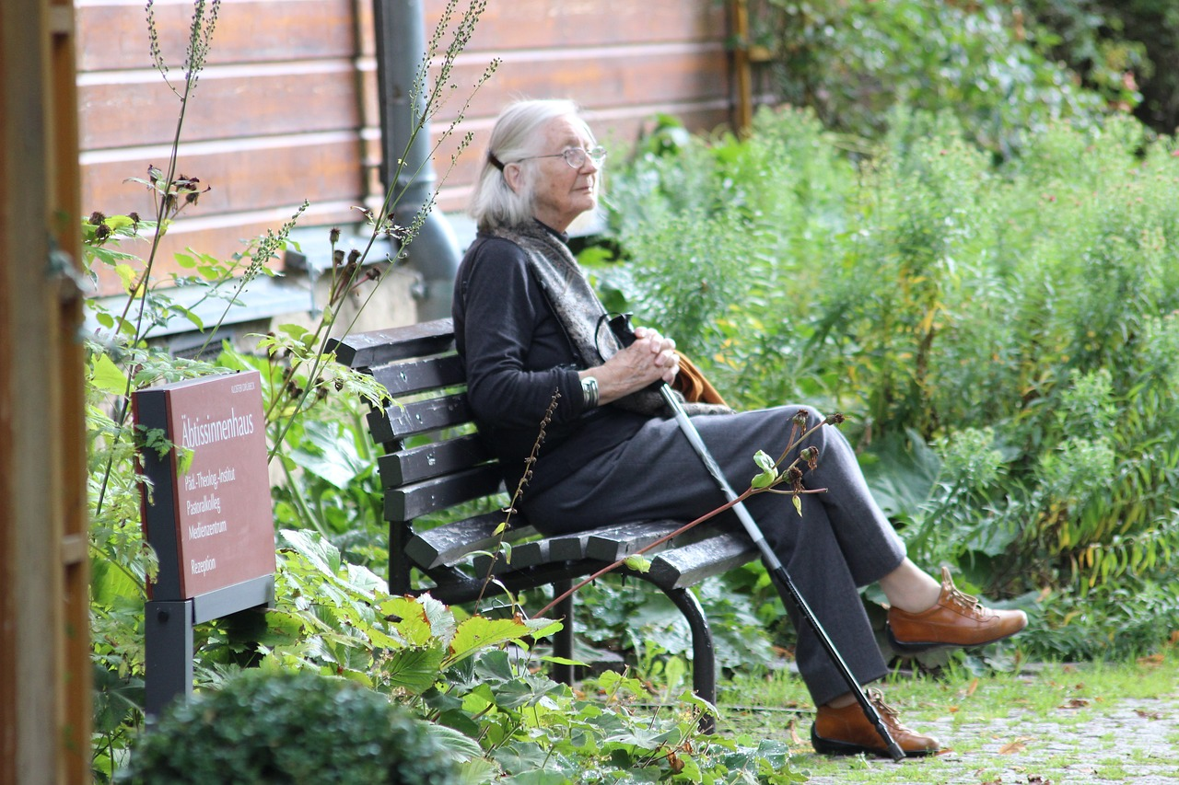
Sory-Time: Health Apps in a Real-Life Scenario
9.1.4 Real-Life integration scenario
Ms. Schmidt is a 79 year old widdow, who recently decided to move to the country side, where her oldest son Thomas lives with his wife Maria and his 4 year old son Christian
She moved to be close to her family
Ms. Schmidt enjoyed exploring the unfamiliar area and going on extensive walks in the beautiful country side of south Germany, especially during the day, when her son and his wife were out the house.
All went well, until…
Source| Pixabay license

Slide 33

Sory-Time: Ms. Schmidt and Health Apps in a Real-Life Scenario
9.1.4 Real-Life integration scenario
…one day Ms. Schmidt walked into a nearby forest, which she enjoyed a lot when the entire family went for a walk on the past weekend.
While on her walk she totally sunk in her thoughts.
Suddenly she felt struck by a strange feeling of confusion.
She continued walking, but the feeling increased so that she felt unwell and then…
Source| Pixabay license

Slide 34
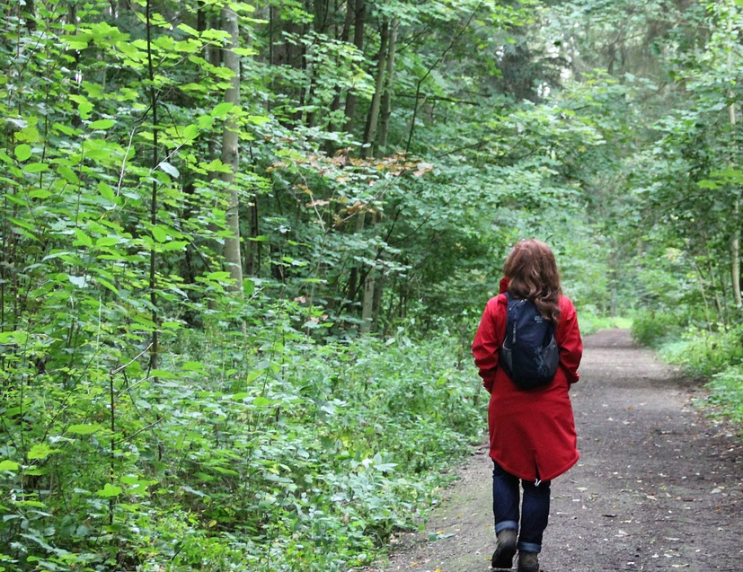
Sory-Time: Ms. Schmidt and Health Apps in a Real-Life Scenario
9.1.4 Real-Life integration scenario
… she decided to stop walking.
Ms. Schmidt slowly came back to her senses and realised that she had no idea where she was, how she got there and what she was even doing.
She tried to remember, but found it hard to concentrate.
After feeling completely lost, she decided to continue walking, until she saw a woman in front of her.
Ms. Schmidt decided to yell out„Hello, please stop! I need help.“
The woman turned around and…
Source| Pixabay license

Slide 35
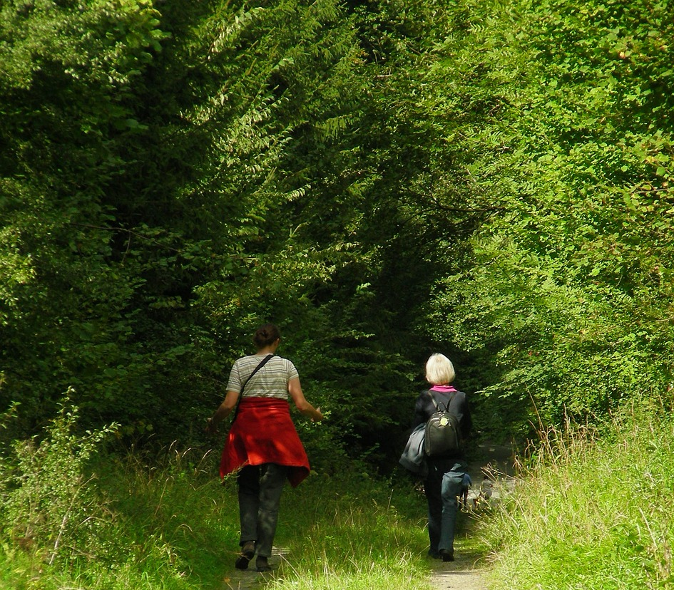
Sory-Time: Ms. Schmidt and Health Apps in a Real-Life Scenario
9.1.4 Real-Life integration scenario
… immediately recognised Ms.Schmidt and said „Hello Ms. Schmidt. How are you? What´s the matter?“
Ms. Schmidt was confused and did not recognise her. She replied „How do you know my name? Can you help me get back to Blackstreet? That‘s where I live.“
The woman was Heidi, a friend of Thomas, who met Ms. Schmidt and her family on their walk in the same forest on the past weekend. They even briefly talked
Heidi realised that something must be off, after Ms. Schmidt could not recognise her. She noticed that Ms. Schmidt seemed to be panicking and offered to help her and walk her home.
At home she decided to tell Thomas and his wife what happend
Source| Pixabay license

Slide 36

Sory-Time: Ms. Schmidt and Health Apps in a Real-Life Scenario
9.1.4 Real-Life integration scenario
After thanking Heidi, Thomas talked to Ms. Schmidt about what happened. Both agreed to visit the doctor.
After several examinations and different doctors the diagnosis followed: Ms. Schmidt experienced her first episode of dementia on the day in the forest. An early form of dementia was diagnosed.
The doctor recommended light medication, since it was not severe dementia.
Ms. Schmidt uttered the fear of not being able to go on walks alone anymore and said that she feels much better now.
The doctor then recommended…
Source| Pixabay license

Slide 37
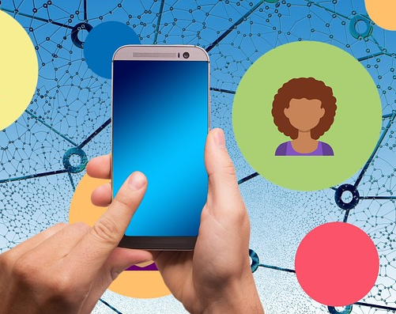
Sory-Time: Ms. Schmidt and Health Apps in a Real-Life Scenario
9.1.4 Real-Life integration scenario
… a smartphone app, that has several tools, which can be helpful to Ms. Schmidt, whenever she feels the risk of another episode rising.
The app allows Ms. Schmidt to send a message to Thomas and inform him of an emergency, when she clicks a panic button. Thomas can then call his mother.
The app allows Thomas to track his mother via GPS Data. He knows where she is, in case of emergency.
The app also recognises if Ms. Schmidt falls to the ground and automically calls emergency services and provides them with her location.
Her son helped her download the app and trained her in using the functionalities
Source| Pixabay license

Slide 38

Sory-Time: Ms. Schmidt and Health Apps in a Real-Life Scenario
9.1.4 Real-Life integration scenario
After some time and with these newly implemented safety precautions Ms. Schmidt finally felt safe again to go on a walk in the forest. She finally felt confident to enjoy nature again.
Thomas felt relieved to know that he can always check where his mother is and feels good about her having the option to also reach emergency services, when he is not available.
However, the doctor also recommended to train her cognitive abilities. He said „You know, there is an app for that!“
Source| Pixabay license

Slide 39

Activity 4: Discuss benefits of Health Apps for key areas of Healthy ageing
9.1.4 Real-Life integration scenario
Now it’s your turn!
Please divide into small groups.
Think of areas of healthy aging in your own life or in the lives of your relatives that could benefit from health apps. (Use the notes you made in Acitivity 2)
What could help or hinder experiencing the benefits in real life. Use the story of Ms. Schmidt for inspiration.
Please take notes for your individual scenario.
Discuss your findings with the group!
Notify me
Cognitive ageing
My dad needs it!
Share it with my son
Medication reminder
Barrier
Benefit
Facilitator
Source| Pixabay license

Slide 40
9.1.5
Exploring, navigating Apps and evaluating potential benefits
Objectives
To explore different Health Apps and apply knowledge and reflection skills on concepts of healthy ageing
To assess potential benefits of Health Apps in ones own live and come up with strategies to experience these
Designed by Freepik

Slide 41
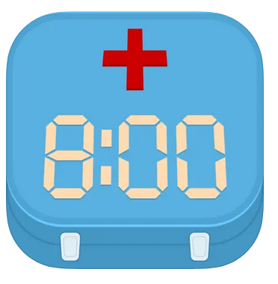




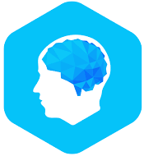





Examples: Available Apps for Healthy Ageing
9.1.5 Exploring, navigating Apps …
Medication Monitoring and Reminder
Meditation practices and sleeping aid
Physical training for seniors
Cognitive Training via Games
Video-Call help for people with limited eye sight
Emergency call for help app
Regional information app for seniors (Germany)
Memory training for people with dementia

Slide 42
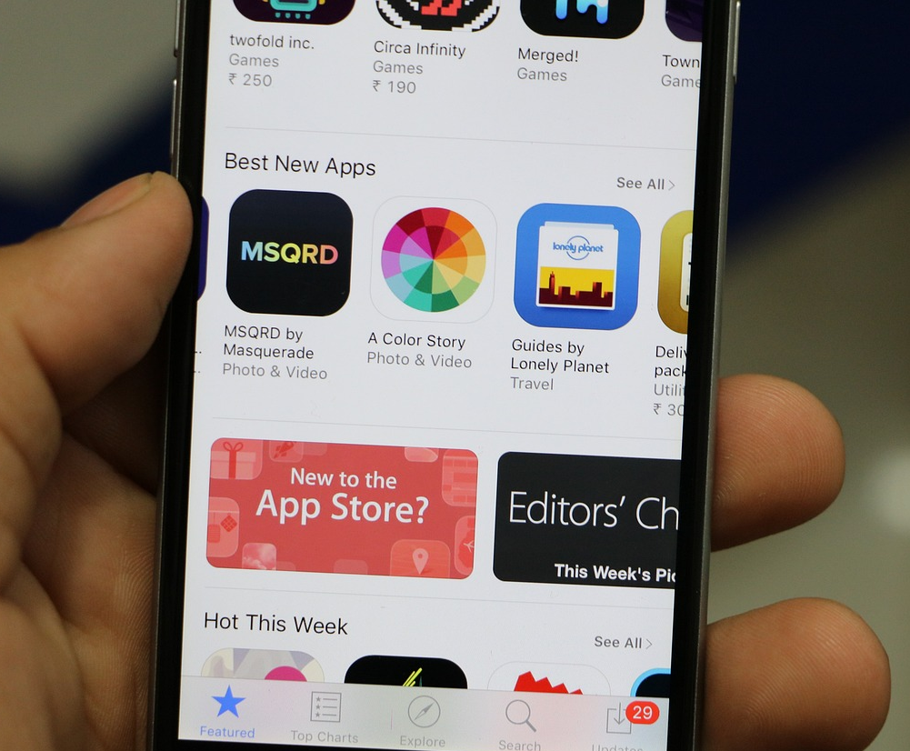
Activity 5: Explore Health Apps
9.1.5 Exploring, navigating Apps …
Now it‘s your turn!
Please choose one app.
Take out your device, go to the app store and download the app to your device.
Explore the app on your own for some minutes. Take a look at features and settings.
Rethink your assessment of potential real-life benefits.
Image by vectorjuice on Freepik
Source| Pixabay license

Slide 43
9.1.6
Discussion and open questions
Objectives
To discuss chosen apps and awaited benefits.
To resolve and clarify misunderstandings that emerged from all previous theoretical information.
To ensure in depth comprehension of the module’s contents.
Designed by Freepik

Slide 44
Activity 6: Please share with the group
9.1.6 Discussion and open questions
Now it‘s your turn!
Why did you choose this particular app?
What area of Healthy ageing are you adressing and why?
What benefits to you await?
What could hinder your consistent use of the app?
What could facilitate your consistent use of the app?
Source| Pixabay license

Slide 45
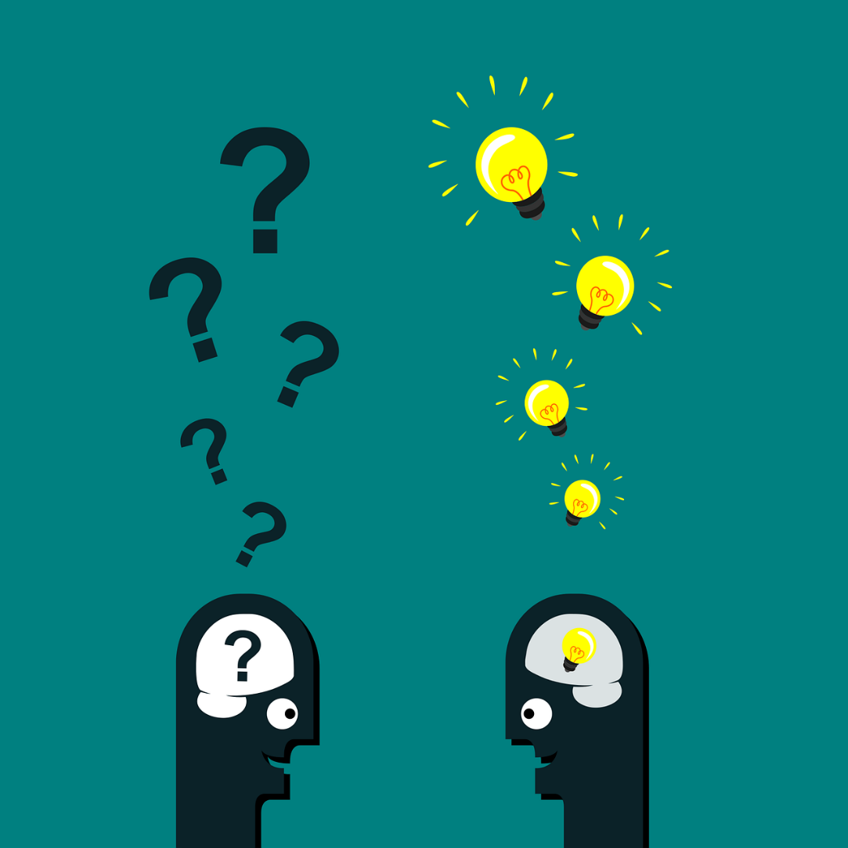
Discussion
9.1.6 Discussion and open questions
Do you have…
Questions?
Clarifications?
Comments?
Source | Pixabay license
Notes:
Hyperlink
Source → https://pixabay.com/vectors/questions-man-head-success-lamp-2519654/

Slide 46
9.1.7
Next steps, evaluation and closure
Objectives
To learn about the next steps in the module.
To evaluate the module.
To learn where to find used references and further readings.
Designed by Freepik

Slide 47

Next steps
9.1.7 Next steps, evaluation and closure
The next session is the Experential Training Activity session.
Here you will learn about one app example for one key area of healthy ageing.
You will learn how to set goals for real-life integration.
You will be invited to complete a real-life –integration challenge and to share your experiences on the e-Training Platform.
Source | Pixabay license

Slide 48
Evaluation Questionnaire
9.1.7 Next steps, evaluation and closure
The content of the module was stimulating and interesting (1 minimum, 5 maximum)
1 | 2 | 3 | 4 | 5
The content of the module was clear, understandable and easy to follow (1 minimum, 5 maximum)
1 | 2 | 3 | 4 | 5
The trainer was well prepared (1 minimum, 5 maximum)
1 | 2 | 3 | 4 | 5

Slide 49
Evaluation Questionnaire
9.1.7 Next steps, evaluation and closure
The module enhanced my knowledge of the subject matter (1 minimum, 5 maximum)
1 | 2 | 3 | 4 | 5
I would recommend this module to others (1 minimum, 5 maximum)
1 | 2 | 3 | 4 | 5
I am satisfied with the module overall (1 minimum, 5 maximum)
1 | 2 | 3 | 4 | 5

Slide 50
References and further readings
United Nations, Department of Economic and Social Afairs (UN DESA). (2020): World Population Ageing 2019. Retrieved from: https://www.un.org/en/development/desa/population/publications/pdf/ageing/WorldPopulationAgeing2019-Report.pdf. Accessed date: November 20, 2023.
National Institute on Aging (NIA). (2020): Understanding the Dynamics of the Aging Process. Retrieved from: https://www.nia.nih.gov/about/aging-strategic-directions-research/understanding-dynamics-aging. Accessed date: November 20, 2023.
World Health Organization. (WHO). (2020): Healthy ageing and functional ability. Retrieved from: https://www.who.int/news-room/questions-and-answers/item/healthy-ageing-and-functional-ability. Accessed date: November 20, 2023.
Pan American Health Organization (PAHO) & World Health Organization (WHO). (2020): Healthy Aging. Retrieved from: https://www.paho.org/en/healthy-aging. Accessed date: November 20, 2023.
Marcussen, L., & Marinus, J. D. (2021). The use of mHealth solutions in active and healthy ageing promotion: An explorative scoping review. Journal of Ideas in Health, 4(1), 307-320. https://doi.org/10.47108/JIDHEALTH.VOL4.ISS1.92

Slide 51
References and further readings
Migration Data Portal. (2023): Older persons and migration. Retrieved from: https://www.migrationdataportal.org/themes/older-persons-and-migration. Accessed date: November 20, 2023.
World Health Organization. (WHO). (2021): Decade of healthy ageing: baseline report. Avaiöable at: https://www.who.int/publications/i/item/9789240017900. Accessed date: November 20, 2023.
Helbostad JL, Vereijken B, Becker C, Todd C, Taraldsen K, Pijnappels M, Aminian K, Mellone S. Mobile Health Applications to Promote Active and Healthy Ageing. Sensors (Basel). 2017 Mar 18;17(3):622. doi: 10.3390/s17030622
Rasche P, Wille M, Bröhl C, Theis S, Schäfer K, Knobe M, Mertens A. Prevalence of Health App Use Among Older Adults in Germany: National Survey. JMIR Mhealth Uhealth 2018;6(1):e26. doi: 10.2196/mhealth.8619.
Portenhauser AA, Terhorst Y, Schultchen D, Sander LB, Denkinger MD, Stach M, Waldherr N, Dallmeier D, Baumeister H, Messner E. Mobile Apps for Older Adults: Systematic Search and Evaluation Within Online Stores. JMIR Aging 2021;4(1):e23313. doi: 10.2196/23313.
Anthony Berauk VL, Murugiah MK, Soh YC, Chuan Sheng Y, Wong TW, Ming LC. Mobile Health Applications for Caring of Older People: Review and Comparison. Therapeutic Innovation & Regulatory Science. 2018;52(3):374-382. doi:10.1177/2168479017725556.
AhmedS A, van Luenen S, Aslam S, van Bodegom D, Chavannes NH. Asystematic review on the use of mHealth to increase physical activity inolder people. Clinical eHealth. 2020;3:31–9. doi: 10.1016/j.ceh.2020.04.002.

Slide 52


Congratulations!
You have completed the teaching session of this module!
Funded by the European Union. Views and opinions expressed are however those of the author(s) only and do not necessarily reflect those of the European Union or the European Education and Culture Executive Agency (EACEA). Neither the European Union nor EACEA can be held responsible for them.

