Slide 1
1
7
2
8
3
9
https://apps4health.eu/
4
Module 8 - Closure session (8.4) Newborn’s care
10
5
11
6
Funded by the European Union. Views and opinions expressed are however those of the author(s) only and do not necessarily reflect those of the European Union or the European Education and Culture Executive Agency (EACEA). Neither the European Union nor EACEA can be held responsible for them.

Slide 2
Partners
UNIVERSITAT DE VALENCIA
VALENCIA, SPAIN
www.uv.es
WESTFALISCHE HOCHSCHULE GELSENKIRCHEN, BOCHOLT, RECKLINGHAUSEN
GELSENKIRCHEN, GERMANY
www.w-hs.de
PROLIPSIS
ATHENS, GREECE www.prolepsis.gr
OXFAM ITALIA INTERCULTURA
AREZZO, ITALY
www.oxfamitalia.org/
CONNEXIONS
ATHENS, GREECE
www.connexions.gr
RESET
CYPRUS
www.resetcy.com
media k GmbH
Bad Mergentheim, GERMANY
www.media-k.eu
COORDINA ORGANIZACIÓN DE EMPRESAS Y RECURSOS HUMANOS, S.L.
VALENCIA, SPAIN
coordina-oerh.com
AMSED
STRASBOURG, FRANCE
www.amsed.fr

Slide 3
Objectives
8
Newborn’s care
Newborns sum-up
Breastfeeding and feeding sum-up
Sleeping habits sum-up.
Newborns’ applications sum-up.
Source: Image by nuraghies on Freepik

Slide 4
Competences
8
Newborn’s care
Give a brief summary of the aspects seen during the sessions.
Design a mental scheme of the concepts.
Image by vectorjuice on Freepik

Slide 5
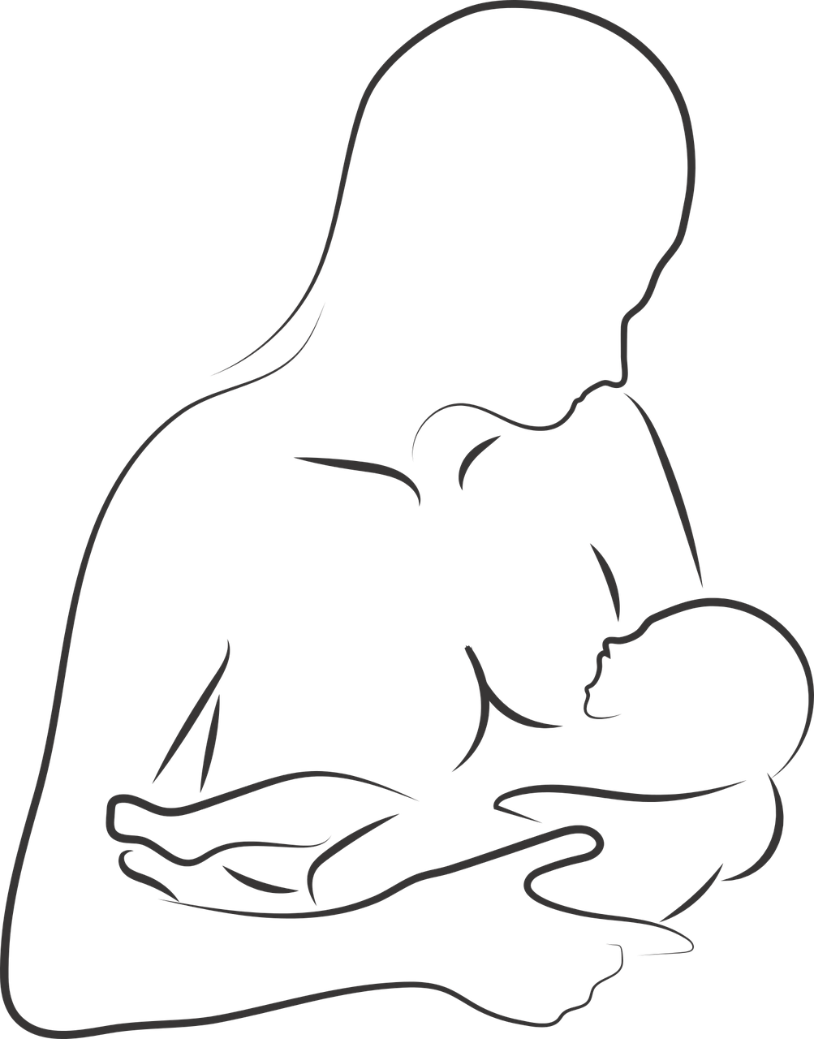
Newborns
Newborns are understood as a period (neonatal period), comprising the first 4 weeks of an infant's life, where rapid changes occur.
Newborns are differentiated according to their gestational age:
Newborn at terms (between 38 and 42 weeks of gestation).
Preterm newborns (before 38 weeks of gestation)
Post-term newborns (after 42 weeks of gestation.)
Source | Pixabay license

Slide 6
Breastfeeding and supplementary feeding
Breastfeeding is a process by which a mother feeds her newborn child through her breasts. However, breastfeeding may not be available or contraindicated for some mothers. In those cases, pasteurized human milk is recommended.
It is recommended to gradually introduce supplementary feeding from 6 months of age onwards. A good option for supplementary feeding includes foods rich in protein, iron and zinc (ie. meat or fish).
Source | license

Slide 7
Sleeping habits
Establishing good sleep habits and routines in newborns is crucial for the baby’s well-being, as sleep disturbances at an early age can have a negative impact on the baby’s cognitive development, behaviour, health, and quality of life.
Depending on the stage of development, a baby needs a specific number of sleeping hours to ensure proper growth
4 - 2 months old → 12 - 16 hours
1 - 2 year(s) old → 11 - 14 hours
3 - 5 years old → 10 - 13 hours
6 - 12 years old → 9 - 12 hours
Source | Pixabay license

Slide 8
Health applications on newborns
There are different types of applications:
Daily records, sleeping habits… (My Baby - Baby Diary y Baby Tracker)
Pediatric advice (Pediamécum AEP)
Breastfeeding (Milk time - timer for nursing)
Feeding (BLW Meals: How to Start Solids)
Source | Palabay license

Slide 9
Provide Feedback & Discuss
Do you think this course has been useful?
Do you think you will use any of the module apps?
From your experience, do you consider that these applications help to achieve the objectives?
Can you comment on any positive experience you have had with the application used?
Designed by Freepik

Slide 10
Congratulations! You have completed this module!
Funded by the European Union. Views and opinions expressed are however those of the author(s) only and do not necessarily reflect those of the European Union or the European Education and Culture Executive Agency (EACEA). Neither the European Union nor EACEA can be held responsible for them.

