Slide 1





1
7
2
8
3
9
https://apps4health.eu/
4
Module 4 – Teaching session (4.1)
Health Apps for Rest Routines
10
5
11
6
Funded by the European Union. Views and opinions expressed are however those of the author(s) only and do not necessarily reflect those of the European Union or the European Education and Culture Executive Agency (EACEA). Neither the European Union nor EACEA can be held responsible for them.

Slide 2

4
Health Apps for Rest Routines

Slide 3











Partners
UNIVERSITAT DE VALENCIA
VALENCIA, SPAIN
www.uv.es
PROLEPSIS
ATHENS, GREECE
www.prolepsis.gr
WESTFALISCHE HOCHSCHULE GELSENKIRCHEN,
BOCHOLT, RECKLINGHAUSEN
GELSENKIRCHEN, GERMANY
www.w-hs.de
OXFAM ITALIA INTERCULTURA
AREZZO, ITALY
www.oxfamitalia.org/
CONNEXIONS
ATHENS, GREECE
www.connexions.gr
RESET
CYPRUS
www.resetcy.com
media k GmbH
Bad Mergentheim, GERMANY
www.media-k.eu
COORDINA ORGANIZACIÓN DE EMPRESAS Y
RECURSOS HUMANOS, S.L.
VALENCIA, SPAIN
coordina-oerh.com
AMSED
STRASBOURG, FRANCE
www.amsed.fr

Slide 4
Teaching Session: Content
1. General information about rest routines
2. Rest routines applications and their benefits
3. Navigating Apps for rest routines
4. Real life scenario
5. Discussion and Evaluation

Slide 5

Objectives
4
Health apps for rest routines
Increase awareness on what is a rest routine and the importance of a rest routine
Identify main activities for establishing a rest routine and how rest routine applications can contribute to that
Understand the main concepts related with Health Apps and how they can be useful for migrants
Develop digital skills and familiarize with the use of rest routine apps
Source: Image by nuraghies on Freepik
Notes:
https://www. dshs.wa.gov/altsa/program-services/nutrition-education
To gain general knowledge on nutrition
To provide adequate knowledge and skills necessary for critical thinking regarding diet and health so the individual can make healthy food choices from an increasingly complex food supply. ΤΡΟΠΟΠΟΙΗΣΕ ΤΟ

Slide 6

Competences
4
Health apps for rest routines
Definition of what is a rest routine and why it is important
Explanation of how rest routine apps can benefit an establishment of a sleeping routine and improve the sleep in general
Familiarization with and capability of navigating different rest routine app and integrate it in the daily life
Image by vectorjuice on Freepik

Slide 7

4.1.1
General information about rest routines
Objectives
To acquire general knowledge on rest routines.
To understand the importance of having a rest routine.
To learn about sleeping difficulties.
Designed by Freepik

Slide 8

Definition of rest routine
4.1.1 General information about rest routines
A rest routine or most commonly known as sleeping routine is the series of activities we follow one or half an hour before going to bed, e.g. turn off the lights, turn off screens, having a specific time going to bed every day, prepare the bed for sleeping, reading a book, etc.
(Sleeping foundation, 2023)
Source | Pixabay license
Notes:
Encyclopedia Britannica: ‘‘Human nutrition is the process by which substances in food are transformed into body tissues and provide energy for the full range of physical and mental activities that make up human life.’’ https://www.britannica.com/science/human-nutrition
Ref:
https://www.fao.org/3/i3261e/i3261e.pdf

Slide 9
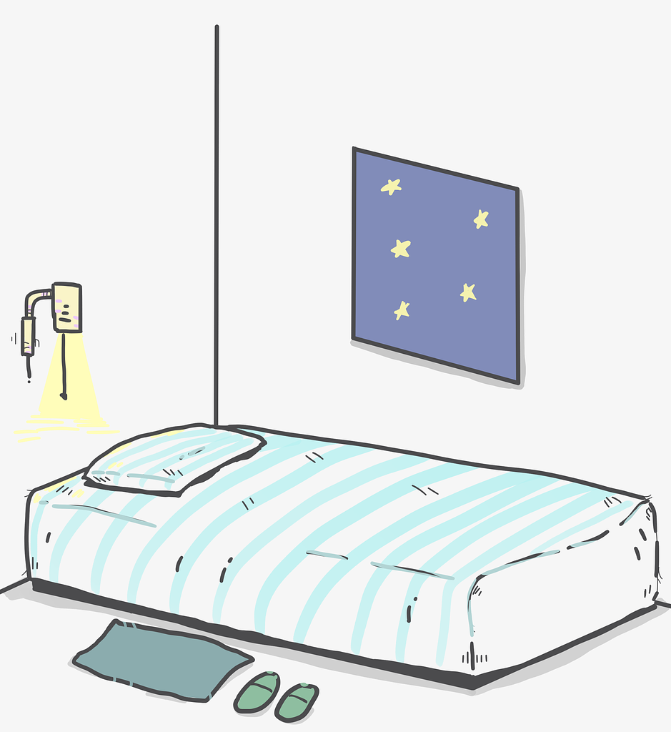
Why sleeping routines are important
4.1.1 General information about rest routines
Sets our “biological” clock
Reduces stress
Improves mood
Maintains a healthy weight
Becoming sick less often
(Office of Disease prevention
& Health Promotion, 2023)
Source | Pixabay license
Notes:
Ref:
https://www.fao.org/3/i3261e/i3261e.pdf

Slide 10
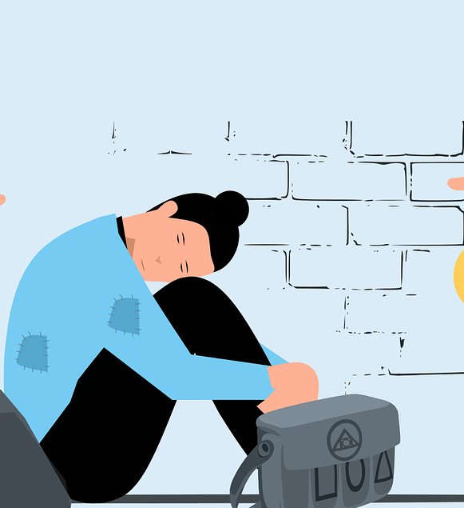
Common sleeping difficulties in migrant populations
4.1.1 General information about rest routines
Sleeping disturbances are mostly related with adaptation stress in the host country, trauma, history of torture or ill-treatment and war
The most common difficulties are:
  Insomnia
  Poor sleeping quality
  Nightmares
  Sleeping for short periods at a time (breaks)
  Sleep paralysis (mostly in refugee populations)
Source | Pixabay license

Slide 11

How to establish a sleeping routine
4.1.1 General information about rest routines
Create and keep a sleep schedule, meaning go to bed and get up every day at the same time, make sure you sleep for 7 hours
If you don’t manage to full asleep in the first 20’ leave your bed and do something relaxing e.g. listen to music and go back when you feel tired
Avoid heavy meals before sleeping or going to bed hungry.
Source | Pixabay license
Notes:
Ref:
https://www.fao.org/3/i3261e/i3261e.pdf

Slide 12
How to establish a sleeping routine
4.1.1 General information about rest routines
Limit naps during the day
Include physical activity in your daily life
If you experience difficult thoughts or worries, try to keep write them down in a notebook
If you suffer from nightmares make sure you have an object next to you that once you wake up can bring you back to the present and make you feel that you are safe
Source | Pixabay license
Notes:
Ref:
https://www.fao.org/3/i3261e/i3261e.pdf

Slide 13

Activity
4.1.1 General information about rest routines
Take some time to think of the following questions and then share with others
What is a rest routine for you?
Have you ever experienced any difficulty with your sleep? What are the most common sleeping difficulties you face or have faced in the past?
What helped you or what is helping you?
Source | Pixabay license
Notes:
Ref:
https://www.fao.org/3/i3261e/i3261e.pdf

Slide 14
4.1.2
Rest routines applications and their benefits
Objectives
To identify reasons for using Apps for rest routines.
To become familiar with the most common types of Apps for rest routines.
Designed by Freepik
Notes:
https://www.who.int/news-room/fact-sheets/detail/healthy-diet
https://www.emro.who.int/nutrition/healthy-eating/index.html
https://www.un.org/nutrition/sites/www.un.org.nutrition/files/nutrition_decade_infographic_1_nutrition_at_a_glance.pdf

Slide 15

Description of Apps for rest routine
4.1.2 Rest routines applications and their benefits
  Applications for rest routines are mobile applications designed and aiming to improve sleep and sleep quality
  With different features sleep applications can help users to establish sleep hygiene practices
Source | Pixabay license
Notes:
Ref:
rehttps://www.fao.org/3/i3261e/i3261e.pdf

Slide 16

Common characteristics of rest routine apps
4.1.2 Rest routines applications and their benefits
Sleep tracking and monitoring
Record and analyze sounds, movements and behaviors during your sleep
Personalized advice for improving sleep, including sleep hygiene education
Relaxation activities and music that can help you relax and sleep smoothly, such as meditation or white noise
Source | Pixabay license
Notes:
Ref:
rehttps://www.fao.org/3/i3261e/i3261e.pdf

Slide 17
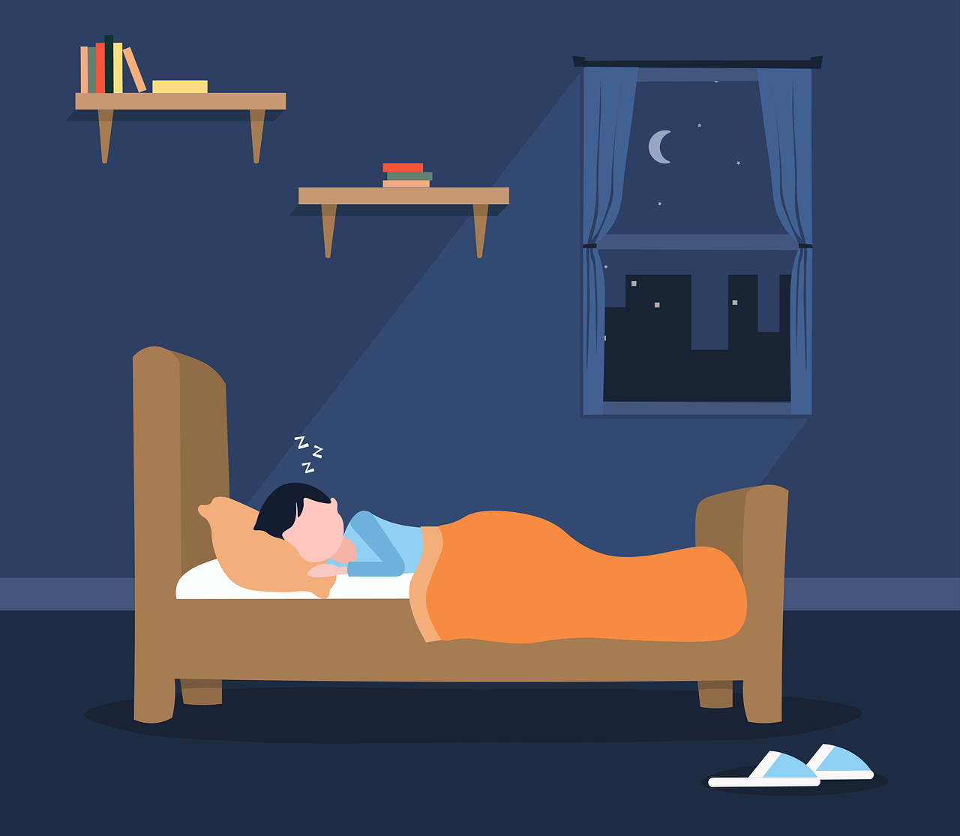
How they can contribute to improving a rest routine
4.1.2 Rest routines applications and their benefits
Improve sleep and sleep quality
Track sleeping habits and provide personalized solutions
Provide relaxation tools, which can be very helpful if you struggle with falling asleep or staying asleep during the night
Source | Pixabay license
Notes:
Ref:
rehttps://www.fao.org/3/i3261e/i3261e.pdf
https://www.emro.who.int/nutrition/healthy-eating/index.html
https://www.who.int/news-room/fact-sheets/detail/healthy-diet
Healthy diet. Cairo: WHO Regional Office for the Eastern Mediterranean; 2019. Licence: CC BY-NC-SA 3.0 IGO.

Slide 18

Activity
4.1.2 Rest routines applications and their benefits
Have you ever used any sleep routine application?
If yes, how was your experience? Was it helpful?
Which were the advantages and the disadvantages of using a mobile application for improving sleeping quality?
Source | Pixabay license
Notes:
Ref:
rehttps://www.fao.org/3/i3261e/i3261e.pdf
https://www.emro.who.int/nutrition/healthy-eating/index.html
https://www.who.int/news-room/fact-sheets/detail/healthy-diet
Healthy diet. Cairo: WHO Regional Office for the Eastern Mediterranean; 2019. Licence: CC BY-NC-SA 3.0 IGO.

Slide 19
4.1.3
Real life scenario
Objectives
To acknowledge the impact of rest routines on human health.
To learn how to manage sleeping difficulties.
Designed by Freepik
Notes:
https://www.un.org/nutrition/sites/www.un.org.nutrition/files/nutrition_decade_infographic_1_nutrition_at_a_glance.pdf
https://www.fao.org/3/i3261e/i3261e.pdf – topic 1 lesson 3

Slide 20
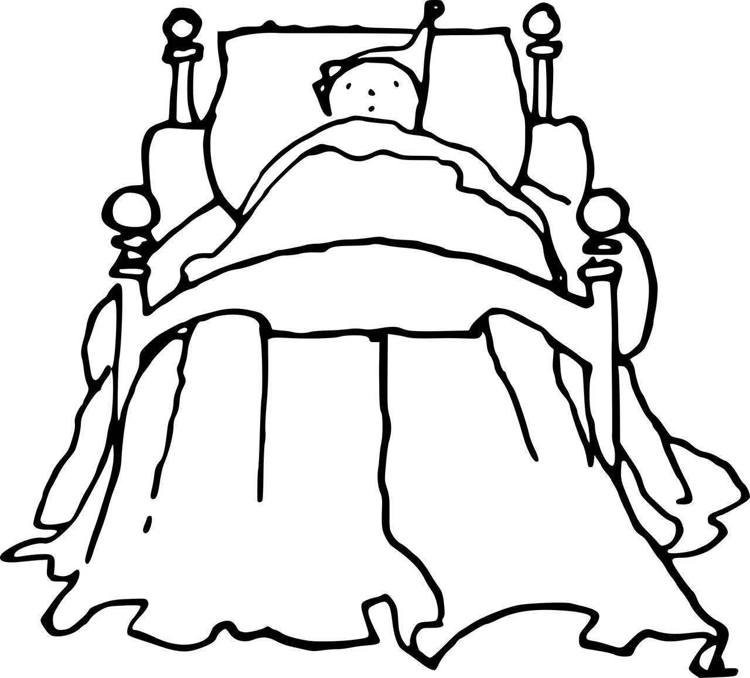
Scenario 1
4.1.3 Real life scenario
Abubakar is a 34-years old man married and has 2 children, aged 4 and 6 years old. He comes originally from Egypt and has lived in Greece for the last 20 years. He owns a small restaurant, which he runs mainly on his own and with his wife. He works a lot during the day, and he returns from work every day really exhausted. The last month he is reporting having difficulties with falling asleep at night. Specifically, he stays awake in his bed for 2 hours and tries to fall asleep, but he can’t. Other than that, his wife told him that during the night he moves a lot in his sleep and seems worried.
Source | Pixabay license
Notes:
Ref:
https://www.emro.who.int/nutrition/healthy-eating/index.html
rehttps://www.fao.org/3/i3261e/i3261e.pdf

Slide 21
6.1.4
Navigating Apps for rest routines
Objectives
To safely explore different apps for rest routines
To get familiar with apps for rest routines
Designed by Freepik
Notes:
Https://pixabay.com/illustrations/goals-smart-target-1262375/

Slide 22
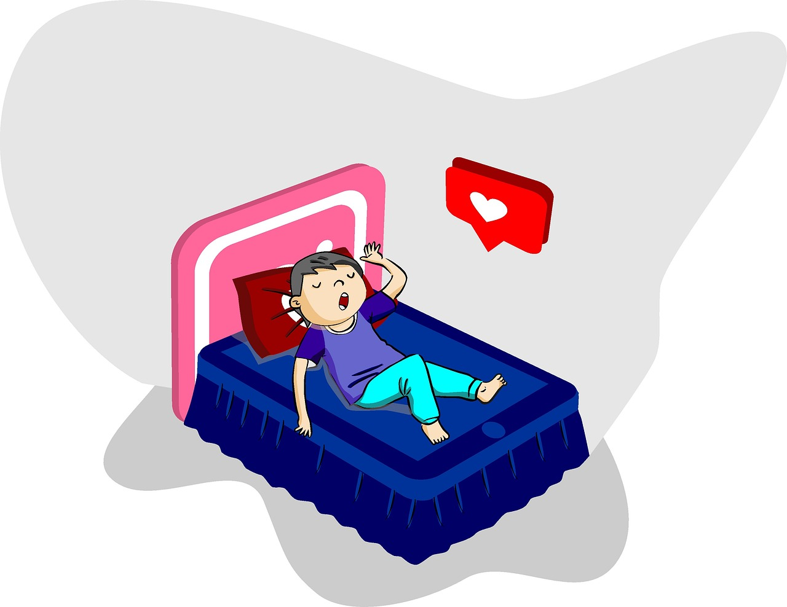
Activity
4.1.4 Navigating Apps for rest routines
Split in groups of 4-5 people
Go to AppStore or Play store
Choose as a group one application and download it
Explore its features
Discuss the advantages and disadvantages
Source | Pixabay license
Notes:
Ref:
rehttps://www.fao.org/3/i3261e/i3261e.pdf
https://www.emro.who.int/nutrition/healthy-eating/index.html
https://www.who.int/news-room/fact-sheets/detail/healthy-diet
Healthy diet. Cairo: WHO Regional Office for the Eastern Mediterranean; 2019. Licence: CC BY-NC-SA 3.0 IGO.

Slide 23
4.1.5
Discussion and Evaluation
Objectives
To resolve and clarify misunderstandings that emerged from all previous theoretical information.
To ensure in depth comprehension of the module’s contents.
To evaluate the module.
Designed by Freepik

Slide 24

To summarize… (1)
4.1.5 Discussion and Evaluation
How are rest routine apps used?
Which are their most common application features and characteristics?
Which are the benefits and the challenges of using them? Which could be the difficulties for integrating them in our daily life?
Source | Pixabay license
Notes:
Hyperlink
Source → https://pixabay.com/vectors/questions-man-head-success-lamp-2519654/

Slide 25
To summarize… (2)
4.1.5 Discussion and Evaluation
A sleeping routine includes the activities we usually perform before sleeping
Among others, mobile applications designed for improving sleeping quality can support us in establishing a healthy and personalized sleeping routine
Main characteristics of rest routine applications are monitor and sleep tracking, personalized sleep hygiene practices, relaxation activities and music, e.g. breathing techniques, white noises
Source | Pixabay license
Notes:
Hyperlink
Source → https://pixabay.com/vectors/questions-man-head-success-lamp-2519654/

Slide 26
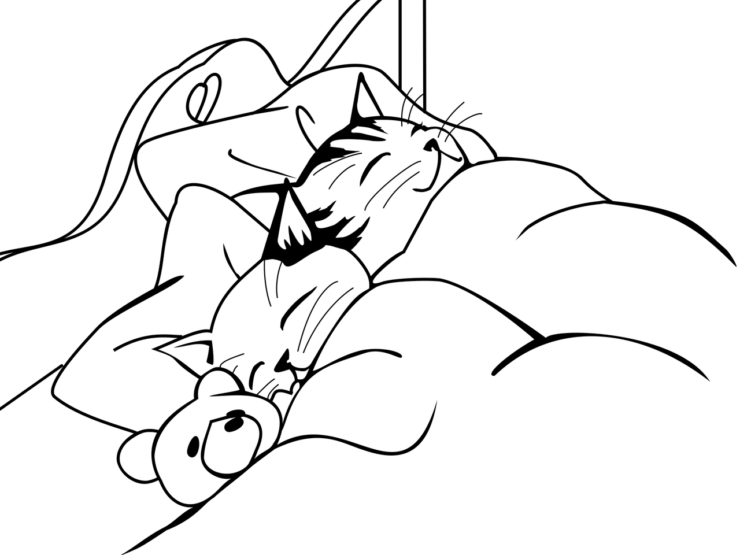
Next steps…
4.1.5 Discussion and Evaluation
Self-assessment questions
Interactive use of a specific rest routine
Rest routine trial by trainees
Source | Pixabay license
Notes:
Hyperlink
Source → https://pixabay.com/vectors/questions-man-head-success-lamp-2519654/

Slide 27
Evaluation Questionnaire
The content of the module was stimulating and interesting (1 minimum, 5 maximum)
1 | 2 | 3 | 4 | 5
The content of the module was clear, understandable and easy to follow (1 minimum, 5 maximum)
1 | 2 | 3 | 4 | 5
The trainer was well prepared (1 minimum, 5 maximum)
1 | 2 | 3 | 4 | 5

Slide 28
Evaluation Questionnaire
The module enhanced my knowledge of the subject matter (1 minimum, 5 maximum)
1 | 2 | 3 | 4 | 5
I would recommend this module to others (1 minimum, 5 maximum)
1 | 2 | 3 | 4 | 5
I am satisfied with the module overall (1 minimum, 5 maximum)
1 | 2 | 3 | 4 | 5

Slide 29
References, further Readings and Closure
Mayo Clinic (2022). Sleep tips: 6 steps to better sleep. Retrieved from https://www.mayoclinic.org/healthy-lifestyle/adult-health/in-depth/sleep/art-20048379
Office of Disease prevention & Health Promotion (2023).
Richter, K., Baumgärtner, L., Niklewski, G., Peter, L., Köck, M., Kellner, S., Hillemacher, T., & Büttner-Teleaga, A. (2020). Sleep disorders in migrants and refugees: a systematic review with implications for personalized medical approach. The EPMA journal, 11(2), 251–260. https://doi.org/10.1007/s13167-020-00205-2
Sleeping foundation (2023). Bedtime Routines for Adults. Retrieved from https://www.sleepfoundation.org/sleep-hygiene/bedtime-routine-for-adults
Sleeping foundation (2022). Best sleep apps. Retrieved from https://www.sleepfoundation.org/best-sleep-apps

Slide 30


Congratulations!
You have completed the teaching session of this module!
Funded by the European Union. Views and opinions expressed are however those of the author(s) only and do not necessarily reflect those of the European Union or the European Education and Culture Executive Agency (EACEA). Neither the European Union nor EACEA can be held responsible for them.

