Slide 1





1
7
2
8
3
9
https://apps4health.eu/
4
Module 3 - Experiential Training session (3.2)
Health Apps for Physical Activity
10
5
11
6
Funded by the European Union. Views and opinions expressed are however those of the author(s) only and do not necessarily reflect those of the European Union or the European Education and Culture Executive Agency (EACEA). Neither the European Union nor EACEA can be held responsible for them.

Slide 2









Partners
UNIVERSITAT DE VALENCIA
VALENCIA, SPAIN
www.uv.es
PROLEPSIS
ATHENS, GREECE
www.prolepsis.gr
WESTFALISCHE HOCHSCHULE GELSENKIRCHEN,
BOCHOLT, RECKLINGHAUSEN
GELSENKIRCHEN, GERMANY
www.w-hs.de
OXFAM ITALIA INTERCULTURA
AREZZO, ITALY
www.oxfamitalia.org/
CONNEXIONS
ATHENS, GREECE
www.connexions.gr
RESET
CYPRUS
www.resetcy.com
media k GmbH
Bad Mergentheim, GERMANY
www.media-k.eu
COORDINA ORGANIZACIÓN DE EMPRESAS Y
RECURSOS HUMANOS, S.L.
VALENCIA, SPAIN
coordina-oerh.com
AMSED
STRASBOURG, FRANCE
www.amsed.fr

Slide 3
Experiential Training Session:
Content
1. Physical activity apps real life navigation and integration
2. Action planning and goal setting

Slide 4

Objectives
3
Health Apps for Physical Activity
To comprehend in depth the theory and implement it on relevant physical activity apps.
To understand, how physical activity apps may enable following healthier dietary habits and may help individuals’ health in general.
Source: Image by nuraghies on Freepik
Notes:
https://www. dshs.wa.gov/altsa/program-services/nutrition-education

Slide 5

Competences
1
Health Apps for Physical Activity
3
To equip participants with the skills to leverage physical activity apps for achieving better lifestyle patterns.
To enhance the skills needed to make informed decisions about app selection, utilization, and integration into participants’ everyday-nutrition, if they wish so.
Image by vectorjuice on Freepik

Slide 6

3.2.1
Physical activity apps real life navigation and integration
Objectives
Integrate exercise apps for tracking progress, setting progress and boosting motivation to improve overall well-being.
Identify features and specification of physical activity apps.
Compare and examine other physical activity apps.
To be familiar with physical activity apps.
Designed by Freepik

Slide 7
Activity 1: Question and Answer (15 mins)
3.2.1 Physical activity apps
What are the benefits of physical activity?
Why you believe physical activity apps are important?
Why you someone should use or not a physical activity app?

Slide 8
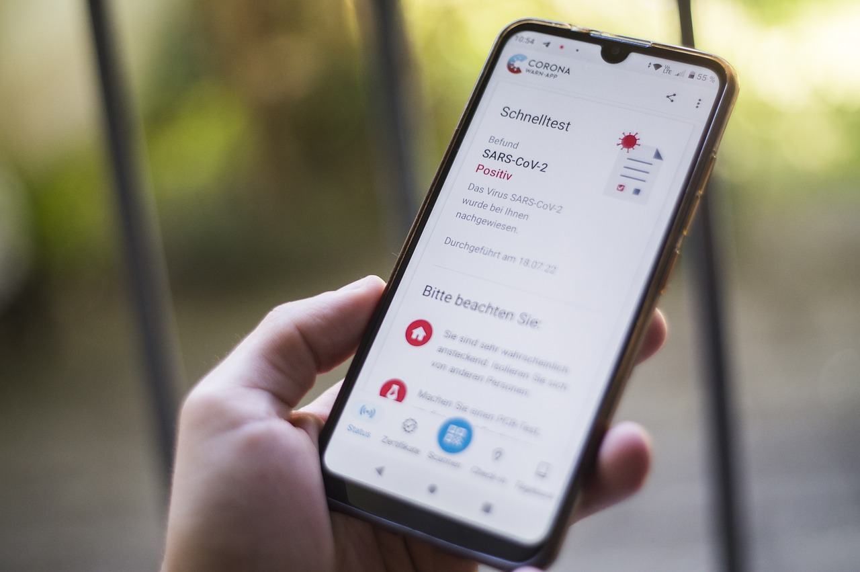
Activity 2: Exercise Apps Navigation
3.2.1 Physical activity apps
Find a fitness app you would like to download (5 mins)
Write down 3 advantages and 3 disadvantages of the app (5 mins)
Think how you could use this app and for which purpose (5-10 mins)
Source | Pixabay license
Notes:
Source: https://pixabay.com/photos/corona-coronavirus-omicron-plague-7329334/

Slide 9
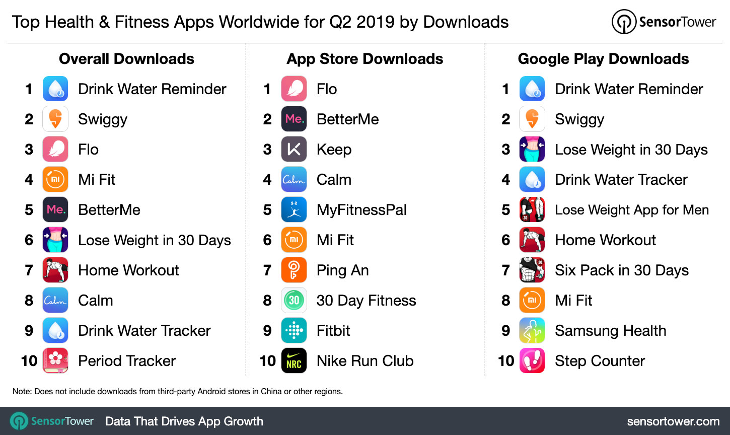
Physical Activity Apps
3.2.1 Physical activity apps
Source
Notes:
Source: https://sensortower.com/blog/top-health-and-fitness-apps-worldwide-q2-2019

Slide 10
Example: Exercise Apps vs Personal Trainer Apps
3.2.1 Physical activity apps
Workout and Exercise Apps
  Offer a wide variety of pre-designed workout routines.
  May not provide personalized recommendations.
  Suitable for individuals who prefer flexibility in their workout choices.
  Examples: Nike Training Club, 7 Minute Workout.
Personal Trainer Apps
  Offer personalized fitness plans based on individual goals, fitness level, and progress.
  Adjust workouts as users improve, ensuring continuous challenge.
  Ideal for users seeking tailored guidance and accountability.
  Examples: Fitbod, Freeletics.
Notes:
REF: https://www.google.com/search?q=types+of+physica%3B+activity+apps&oq=types+of+physica%3B+activity+apps&gs_lcrp=EgZjaHJvbWUyBggAEEUYOTIJCAEQABgNGIAEMgkIAhAAGA0YgAQyCQgDEAAYDRiABDIJCAQQABgNGIAEMggIBRAAGA0YHjIICAYQABgWGB4yCAgHEAAYFhgeMggICBAAGBYYHjIICAkQABgWGB7SAQg0NDk2ajBqNKgCALACAA&sourceid=chrome&ie=UTF-8

Slide 11
Activity 3: Comparing Exercise Apps
3.2.1 Physical activity apps
Compare features and functionalities of different types of apps: Choose different types of apps and compare with other types. Then match each app with the fitness goals you believe is best suited for that app.

Slide 12
3.2.2
Action planning and goals setting
Objectives
Understand the importance of action planning and goal setting in promoting physical activity.
Identify key features of physical activity apps that facilitate effective action planning and goal setting.
Learners to set their own nutrition-related SMART goals and intergrade them in exercise apps.
Designed by Freepik

Slide 13
SMART Goals
3.2.2 Action Planning
S: Specific (setting your goals)
M: Measurable (measuring success)
A: Attainable (Setting achievable goals)
R: Relevant (Setting goals relevant to your career or education)
T: Time (Deadlines)

Slide 14
Why to Action Plan
3.2.2 Action Planning
Clarity of Purpose
Motivation and Accountability
Measurable Progress
Time Management
Long-Term Sustainability
Structured Approach
Long-Term Sustainability

Slide 15

Setting & implementing a physical activity-related SMART goals
3.2.2 Goal Setting
Activity
Set your own physical activity-related SMART goal
Share your goal with the rest of the group.
Check whether it is a SMART goal (fulfill prerequisites?).
Is it related to a specific exercise you want to achieve, is it related to body weight or a health condition?
Why did you choose this goal?
Image by vectorjuice on Freepik

Slide 16

Setting & implementing a physical activity-related SMART goals
3.2.2 Goal Setting
Brainstorm and discuss:
How could you integrate these goals in a physical activity apps?
What kind of app will you use to track the progress of your goal?
Is there a difficulty you might face?
Designed by Freepik

Slide 17
Setting Goals
SMART Goals
SPECIFIC
MEASURABLE
ACHIEVABLE
RELEVANT
TIME-BOUND
*This table could be used to set physical activity-related SMART goals.

Slide 18


Congratulations!
You have completed the experiential training session of this module!
This project has been funded with support from the European Commission. This publication (communication) reflects the views only of the author, and the Commission cannot be held responsible for any use which may be made of the information contained therein.

